Slide 1


Esse3 Guidelines
Personal data

Slide 2

WHAT IS ESSE3?
Esse3 is the informatic system of Università Europea di Roma.
In order to be registered to Esse3 as International Students you have to : 1. Go to MyUER> Esse3

Slide 3

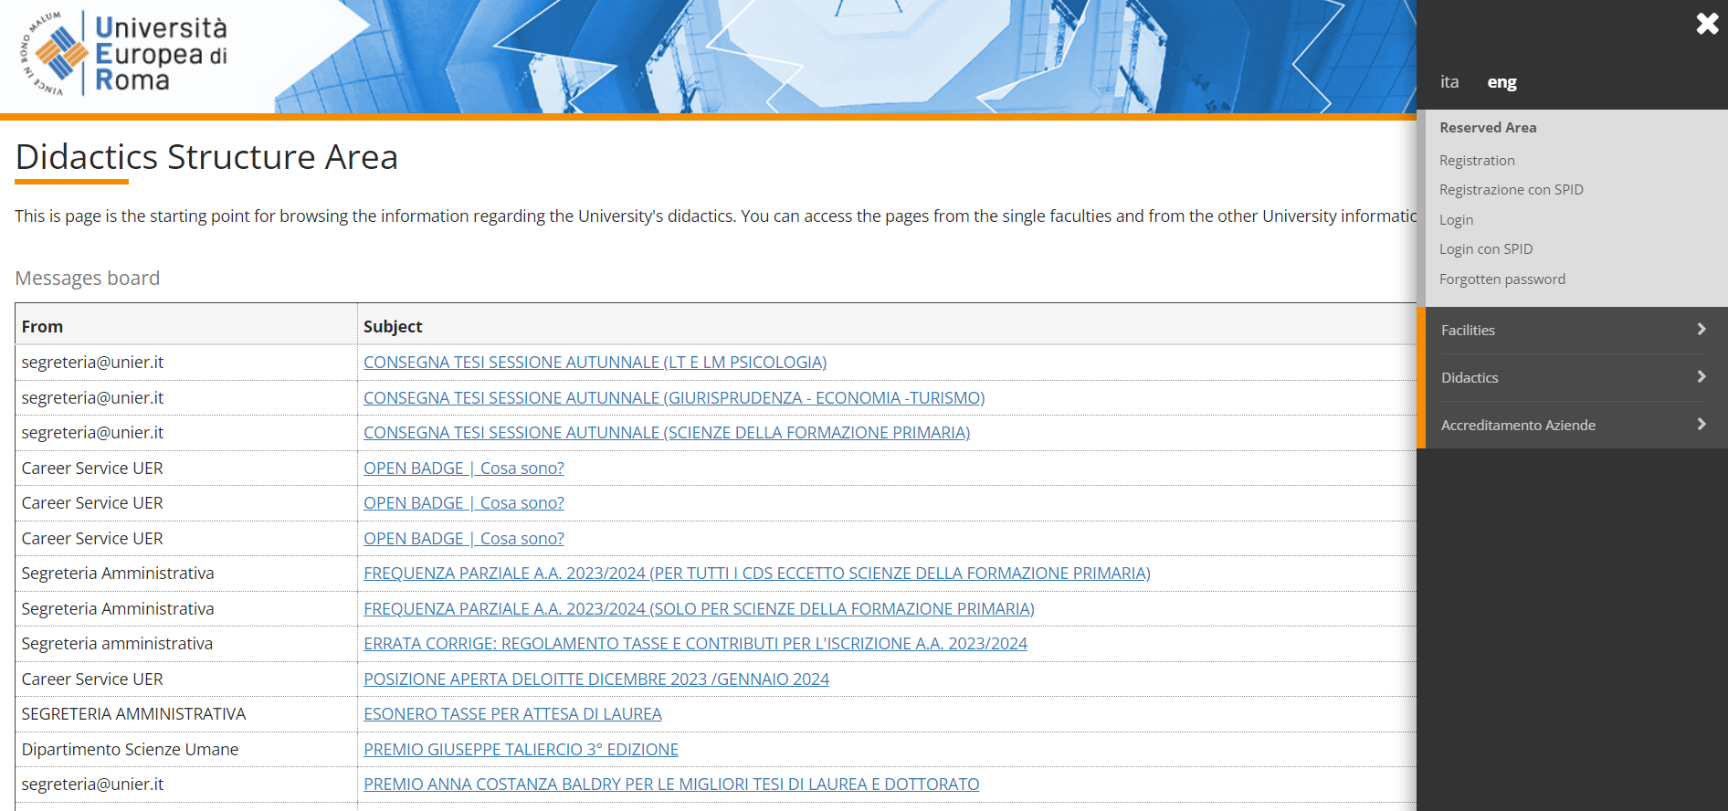
2. Menu > Eng
TYPES OF LEARNING AGREEMENT
PAPER-BASED
ONLINE
ERASMUS+ STUDENTS (EUROPEAN UNION)

Slide 4
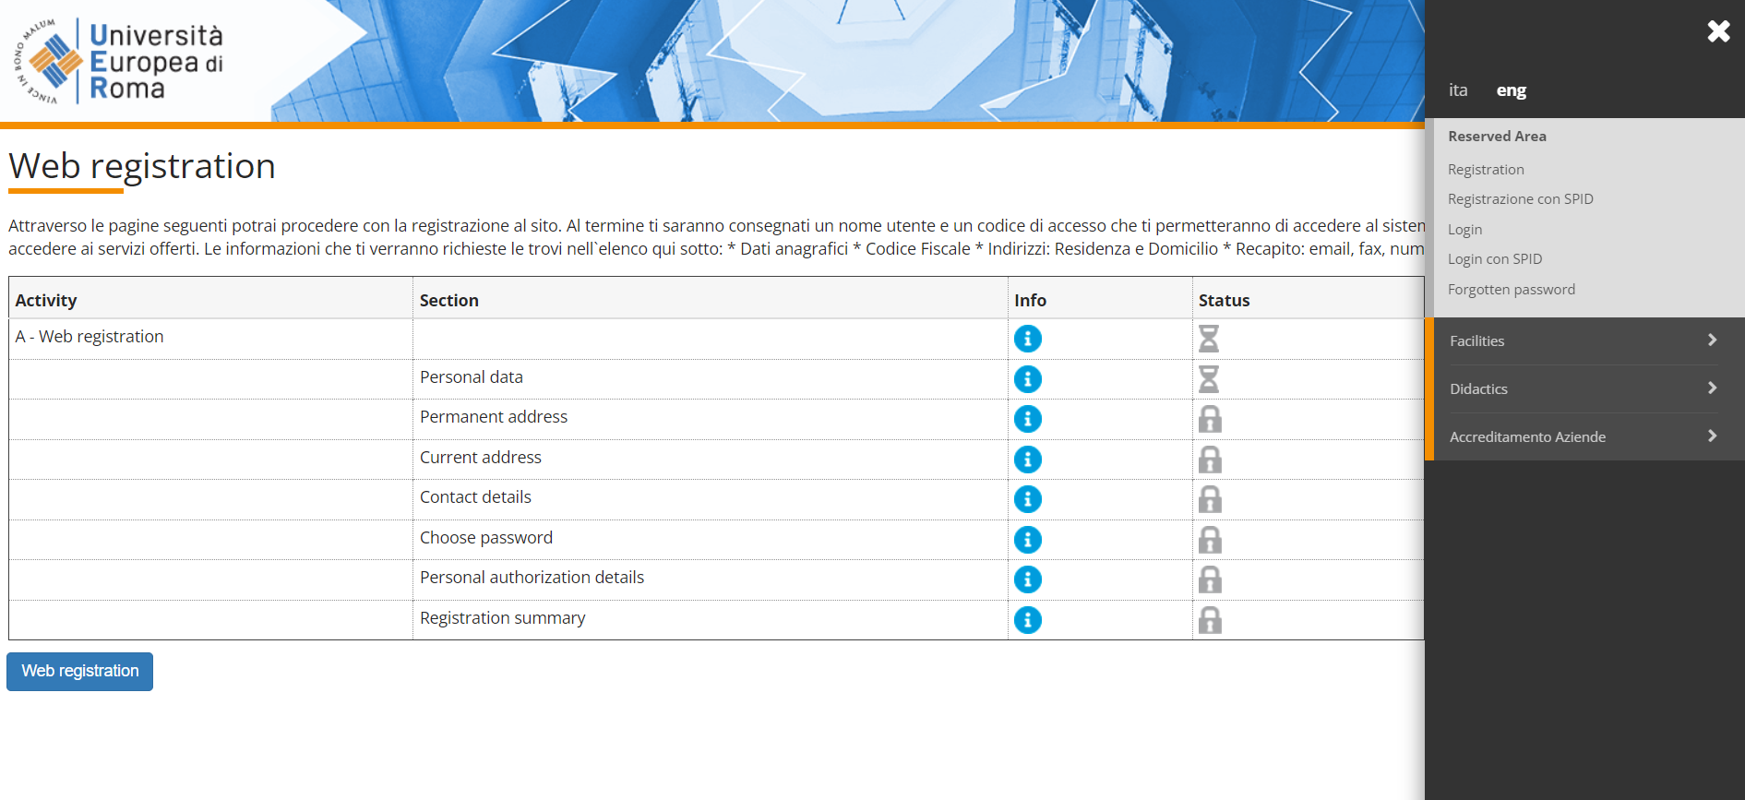
3. Menu > Registration
TYPES OF LEARNING AGREEMENT
PAPER-BASED DICTAMEN
ANÁHUAC STUDENTS (MEXICO)

Slide 5
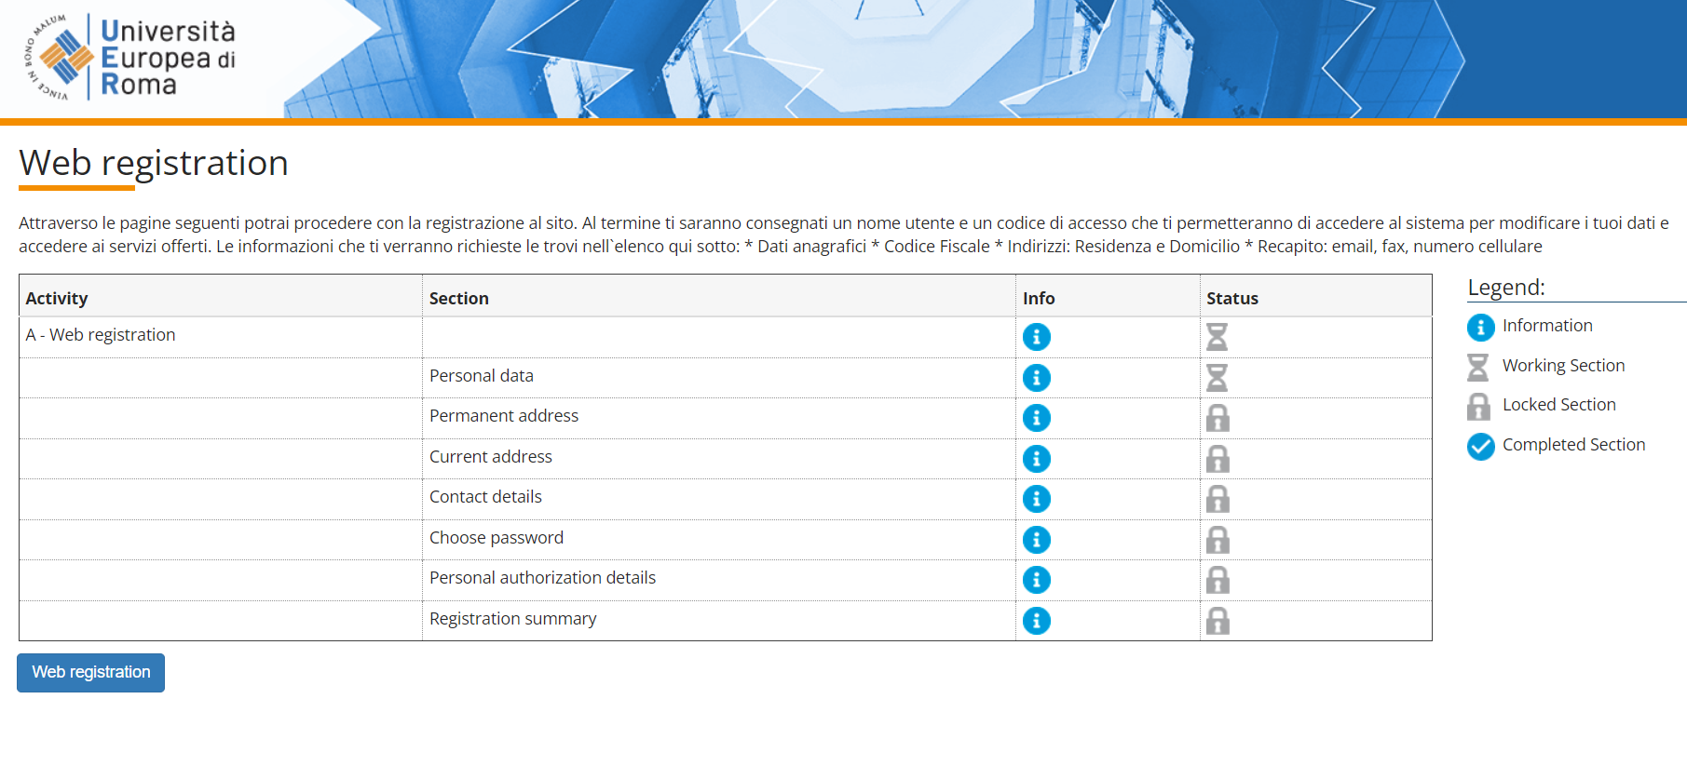
4. Web registration
TYPES OF LEARNING AGREEMENT
PAPER-BASED DICTAMEN
ANÁHUAC STUDENTS (MEXICO)

Slide 6
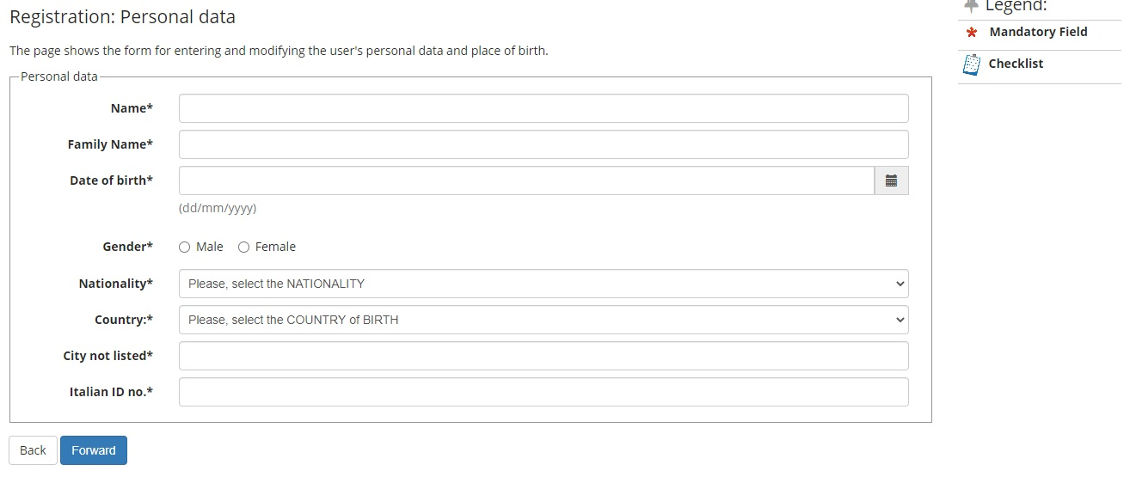
5. Fill in your personal data and click on “Forward”
NB: Please enter your complete name(s) and surname(s) including special characters and accent marks
TYPES OF LEARNING AGREEMENT
ANÁHUAC STUDENTS (MEXICO)
Leave in blank the "Italian ID no." field if you do not have one yet"

Slide 7
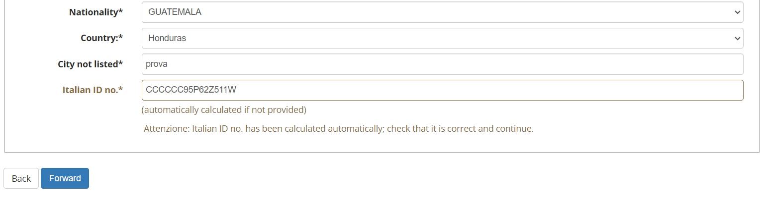
6. You will read “Attenzione: Italian ID no. has been calculated automatically;
check that it is correct and continue.” That is fine, click on “Forward”
TYPES OF LEARNING AGREEMENT
ANÁHUAC STUDENTS (MEXICO)

Slide 8

7.Complete the “Registration: Permanent address” section and click on “Forward”. (PERMANENT ADDRESS = ADDRESS IN YOUR HOME COUNTRY)
8. Complete the “Registration: Current address” section and click on “Forward”. (CURRENT ADDRESS = ADDRESS IN ITALY)
9. Complete the “Registration: Delivery details” section and click on “Forward”. (DELIVERY ADDRESS = ADDRESS IN ITALY)

Slide 9
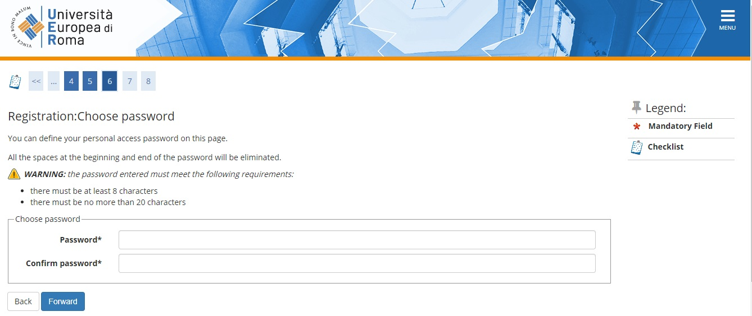
10. Choose your password and click on “Forward”
TYPES OF LEARNING AGREEMENT
ANÁHUAC STUDENTS (MEXICO)

Slide 10
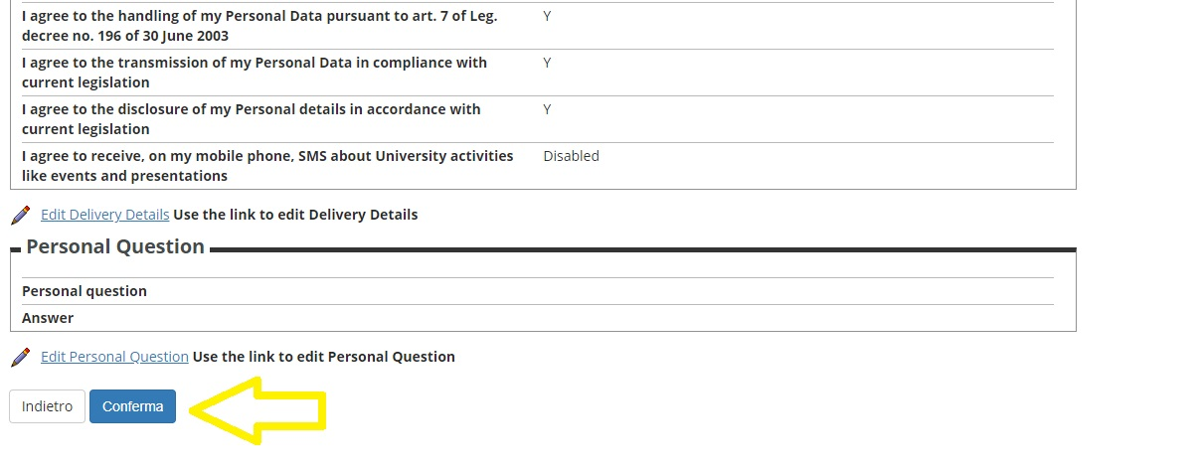
11. Check the summary and click on “Conferma”
TYPES OF LEARNING AGREEMENT
ANÁHUAC STUDENTS (MEXICO)

Slide 11

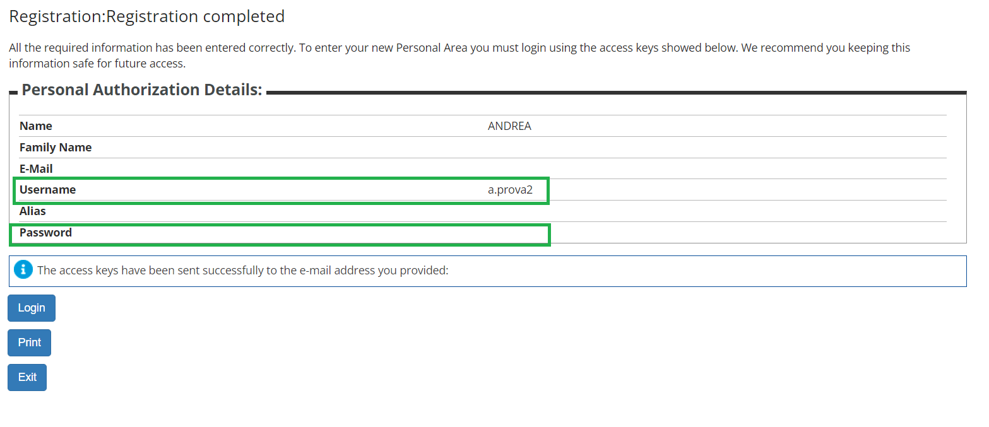
Congratulations! You completed the procedure!
12. Write down your Username and Password > Exit
TYPES OF LEARNING AGREEMENT
ANÁHUAC STUDENTS (MEXICO)

Slide 12


