Slide 1
LEARNING AGREEMENT
DURING MOBILITY

Slide 2
WHAT IS THE LEARNING AGREEMENT?
The Learning Agreement (LA) is a document containing the subjects that you are going to study at UER, agreed among you, your home University and UER.
It also contains the subjects that will be recognized by your home University.

Slide 3
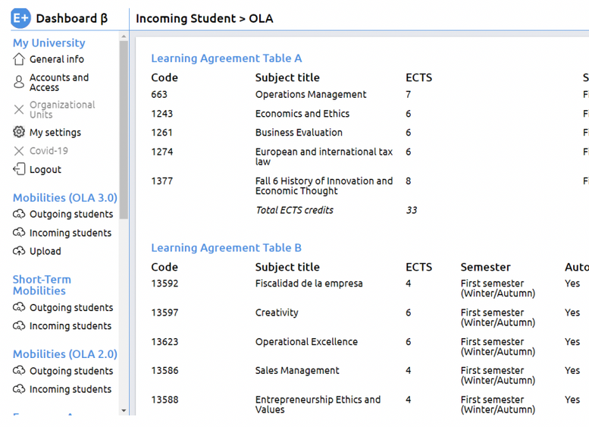
TYPES OF LEARNING AGREEMENT
PAPER-BASED
ONLINE
ERASMUS+ STUDENTS (EUROPEAN UNION)
Erasmus+ students need to submit either the paper-based Learning Agreement OR the OLA (not both), according to what their home university indicates.

Slide 4
TYPES OF LEARNING AGREEMENT
PAPER-BASED DICTAMEN
ANÁHUAC STUDENTS (MEXICO)

Slide 5
TYPES OF LEARNING AGREEMENT
Ask your home University for your local Learning Agreement form.
All Learning Agreement forms have the same parts (personal data, courses at sending institution, courses at receiving institution & signatures).
OTHER TYPES OF LEARNING AGREEMENTS (CHILE, KOREA, ETC)

Slide 6
PARTS OF THE LEARNING AGREEMENT/DICTAMEN
1. Learning Agreement Before Mobility/Predictamen
Provisional subjects
Deadline: 1st September
2. Learning Agreement During Mobility/Dictamen Final
Definitive subjects
Deadline: 3rd October

Slide 7
LA BEFORE MOBILITY/PREDICTAMEN
Subjects at UER
Recognized subjects at your home university
Signatures

Slide 8
LA BEFORE MOBILITY/PREDICTAMEN
Subjects at UER
Recognized subjects at your home university
Signatures

Slide 9
LA DURING MOBILITY/DICTAMEN FINAL
Subjects at UER
Recognized subjects at your home university
Signatures

Slide 10
LA DURING MOBILITY/DICTAMEN FINAL
Subjects at UER
Recognized subjects at your home university
Signatures

Slide 11
IMPORTANT CONSIDERATIONS ABOUT THE LEARNING AGREEMENT DURING MOBILITY/DICTAMEN FINAL
WHAT'S FOR?
WHERE?
HOW?
WHEN?
To make changes to your previous Learning Agreement Before Mobility/Predictamen.
The form will be provided by your Home University. Alternatively, you can download it from the International Student Guide.
(*Not applicable to OLA)
One single PDF containing both:
1. Learning Agreement Before Mobility/Predictamen (1st page)
+
2. Learning Agreement During Mobility/Dictamen final (2nd page) (*Not applicable to OLA)
Send it to UER IR Office once it is already signed by your Home Coordinator and you
Until October 3rd to submit it to UER IR Office.
Only subjects notified within October 3rd will appear in the final Transcript of Records.

Slide 12
NECESSARY INFORMATION TO FILL IN THE LA DURING MOBILITY/
DICTAMEN FINAL
Università Europea di Roma - Erasmus code: I ROMA23 (for EU students only)
Name of the university on the Online Learning Agreement platform: Università degli Studi Europea (for EU students only)
Course Catalogue

Slide 13
CONTACTS
Contact person at the receiving institution:
Dott.ssa Laura Polimadei
laura.polimadei@unier.it
Dott.ssa Francesca Chiriani
francesca.chiriani@unier.it
Dott.ssa Giulia Landolina
Giulia.landolina@unier.it
Responsible person at the receiving institution:
Prof. Aniello Merone
aniello.merone@unier.it

