Slide 1
LEARNING AGREEMENT
BEFORE MOBILITY

Slide 2
WHAT IS THE LEARNING AGREEMENT?
The Learning Agreement (LA) is a document containing the subjects that you are going to study at UER, agreed among you, your home University and UER.
It also contains the subjects that will be recognized by your home University.

Slide 3
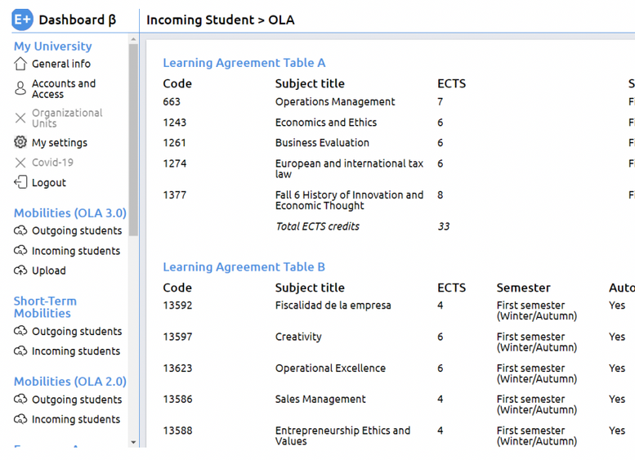
TYPES OF LEARNING AGREEMENT
PAPER-BASED
ONLINE
ERASMUS+ STUDENTS (EUROPEAN UNION)

Slide 4
TYPES OF LEARNING AGREEMENT
PAPER-BASED DICTAMEN
ANÁHUAC STUDENTS (MEXICO)

Slide 5
TYPES OF LEARNING AGREEMENT
Ask your home University for your local Learning Agreement form.
All Learning Agreement forms have the same parts (personal data, courses at sending institution, courses at receiving institution & signatures).
OTHER TYPES OF LEARNING AGREEMENTS (CHILE, KOREA, ETC)

Slide 6
PARTS OF THE LEARNING AGREEMENT/DICTAMEN
1. Learning Agreement Before Mobility/Predictamen
Provisional subjects
Deadline: September 1st
2. Learning Agreement During Mobility/Dictamen Final
Definitive subjects
Deadline: 3rd October

Slide 7
LA BEFORE MOBILITY/PREDICTAMEN
Subjects at UER
Recognized subjects at your home university
Signatures

Slide 8
LA BEFORE MOBILITY/PREDICTAMEN
Subjects at UER
Recognized subjects at your home university
Signatures

Slide 9
IMPORTANT CONSIDERATIONS ABOUT THE LEARNING AGREEMENT BEFORE MOBILITY/PREDICTAMEN
WHAT'S FOR?
WHERE?
HOW?
WHEN?
IS IT PROVISIONAL?
To agree among you, your home university and UER your provisional courses at UER and their recognition at your home university.
The form will be provided by your Home University. Alternatively, you can download it from UER International Student Guide. (*Not applicable to OLA)
You need to send it to UER once it is already signed by both you and your home university. It should contain the same courses that you have already included in your
UER Exchange Application Form
Until September 1st to submit it to UER, already signed by you and your home university.
Yes. Once the schedules will be published and the lessons started, you will have 2 weeks to make the necessary changes.

Slide 10
NECESSARY INFORMATION TO FILL IN THE LA BEFORE MOBILITY/
PREDICTAMEN
Università Europea di Roma - Erasmus code: I ROMA23 (for EU students only)
Name of the university on the Online Learning Agreement platform: Università degli Studi Europea (for EU students only)
Course Catalogue

Slide 11
CONTACTS
Contact person at the receiving institution:
Dott.ssa Laura Polimadei
Dott.ssa Francesca Chiriani
laura.polimadei@unier.it
Dott.ssa Giulia Landolina
giulia.landolina@unier.it
Responsible person at the receiving institution:
Prof. Aniello Merone
aniello.merone@unier.it

