Slide 1


Exams registration and grade validation guidelines

Slide 2




Extraordinary spring session
(50% attendance required - May)
AND/OR
Regular summer session (June-July)
Each session provides 3 exam calls per subject.
You can choose the day you are more comfortable with and still have access to the other two.
Keep in mind that published dates may be subject to change due to
unforeseen events or high volume of students booked.
We highly recommend to not postpone any exam.

Slide 3





1st Step: Do the Evaluation Questionnaire and Register for the exam
ESAME
2nd Step: Take the exam
3rd Step: Accept or Refuse the grade

Slide 4
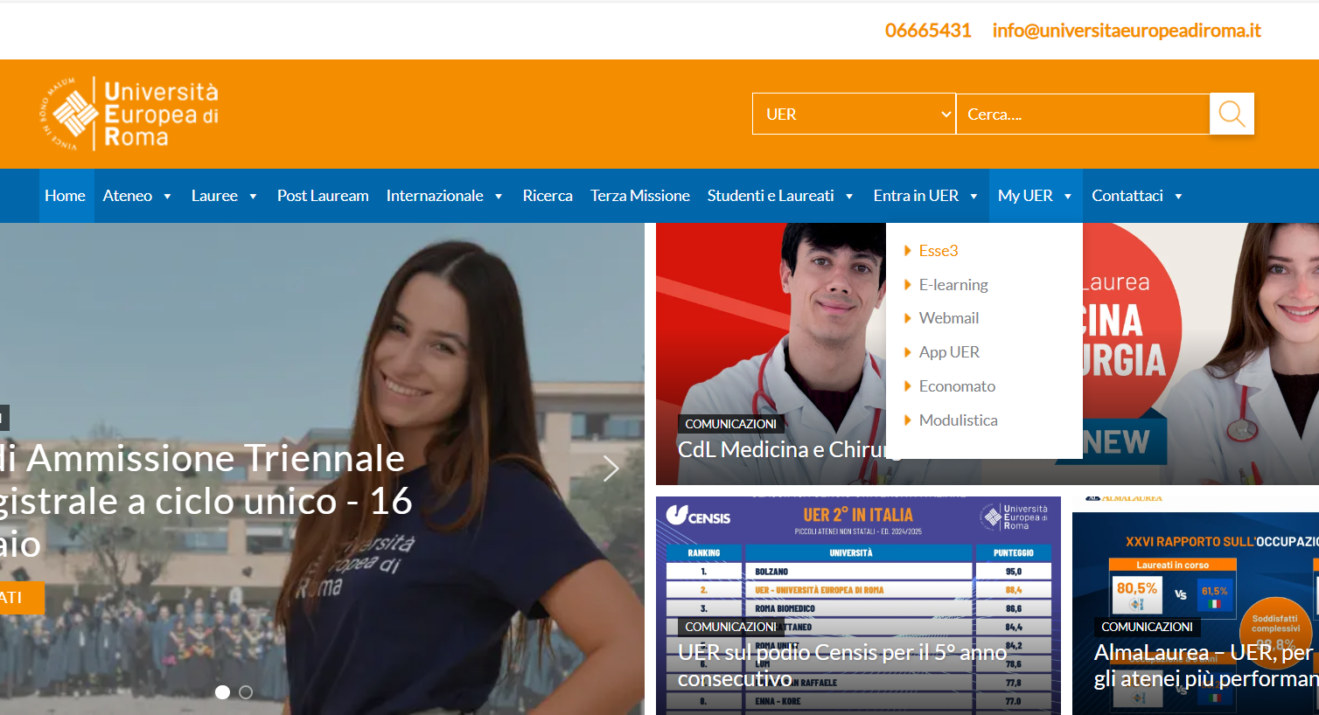
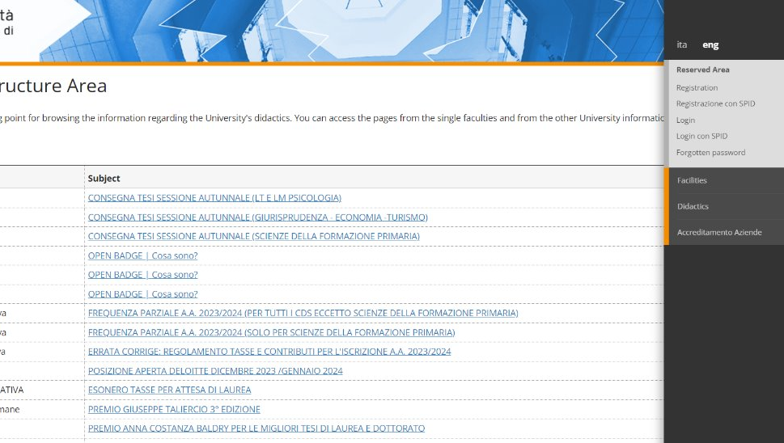
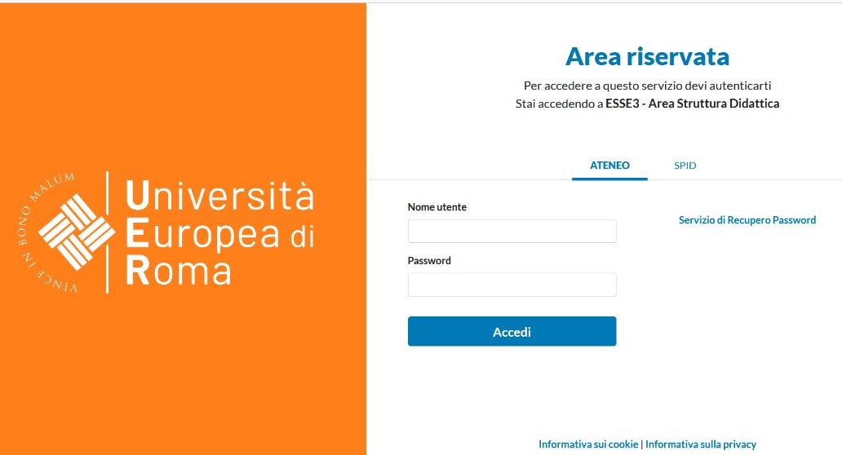
1st Step: Registration
ANÁHUAC STUDENTS (MEXICO)
Go on the university website on the section My UER > Esse3 > Log in and using your credentials enter in the system.

Slide 5
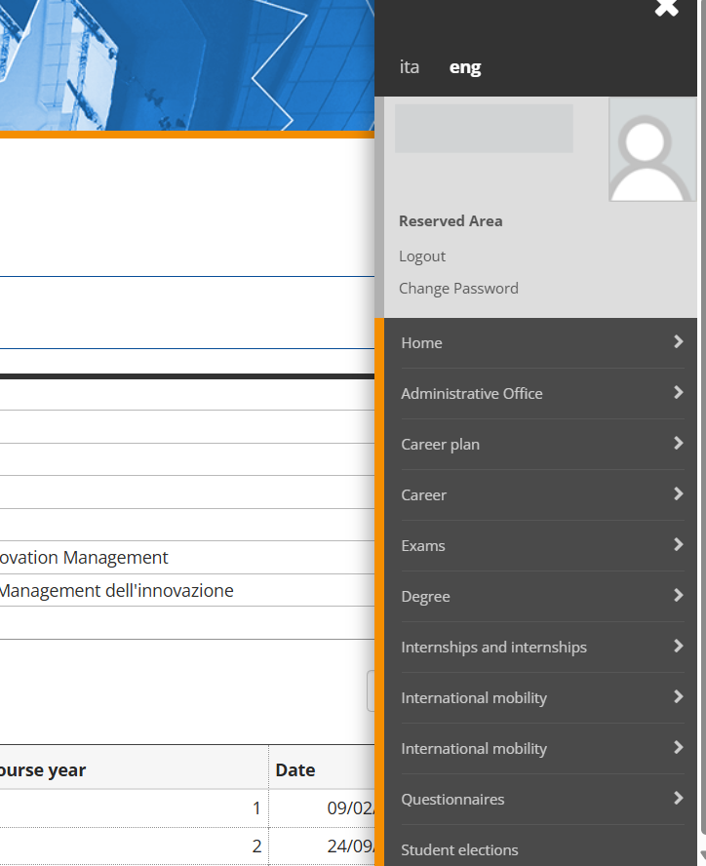
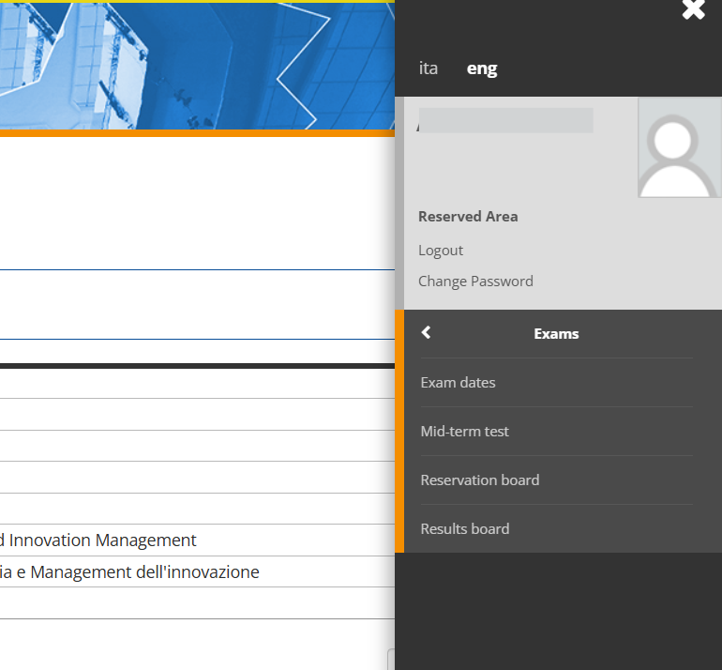
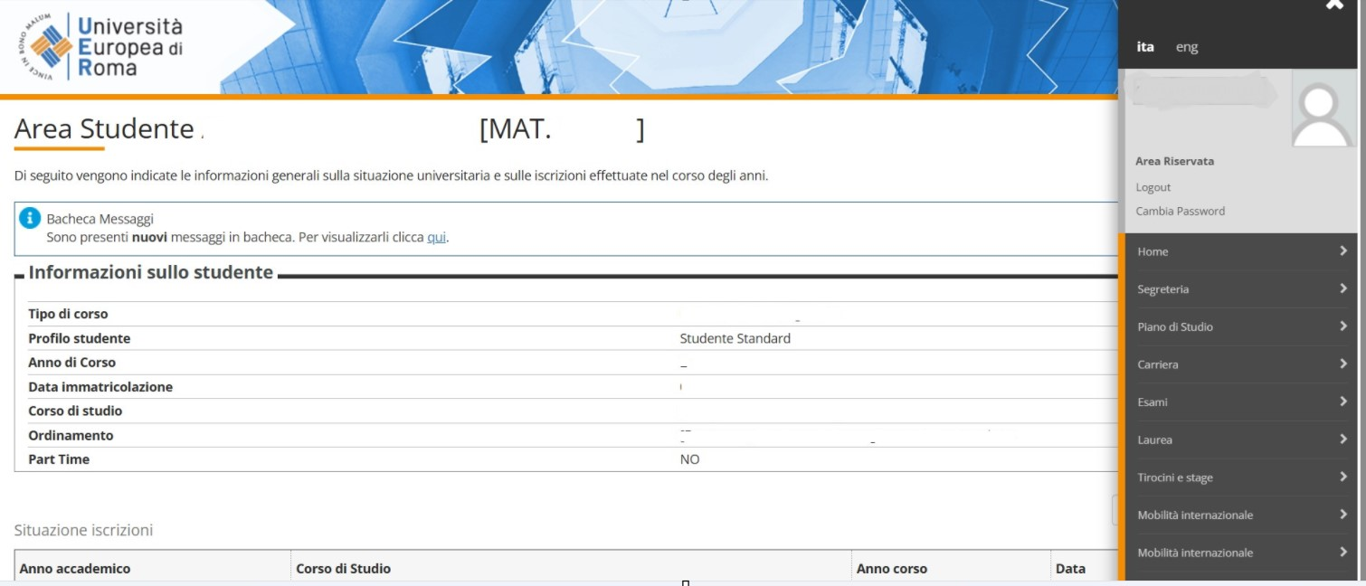
From the menu on the right select Segreteria (Segretariat) > Sessione di esami (Exams) > Reservation board.

Slide 6
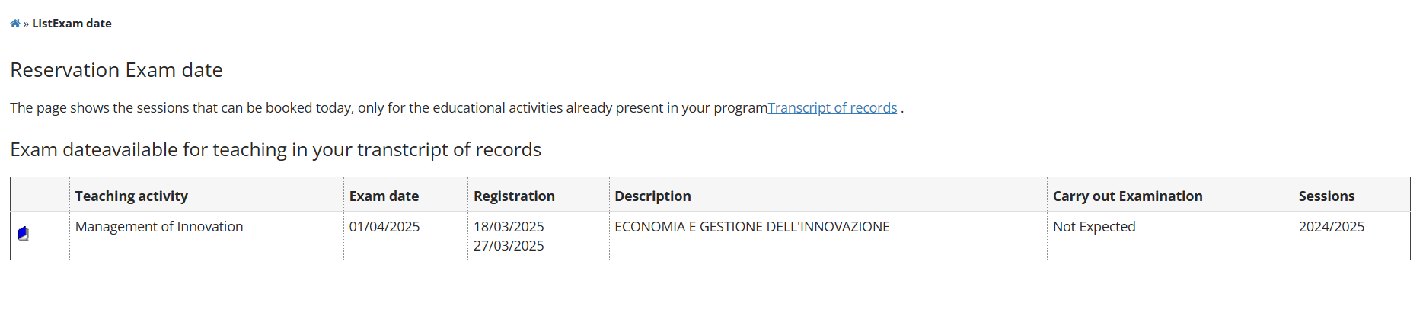
Exams whose registration is available will be displayed.
Remember that it is possible to register for an exam from 14 up to 5 days before the exam.
To register for an exam click on the blue book icon.

Slide 7
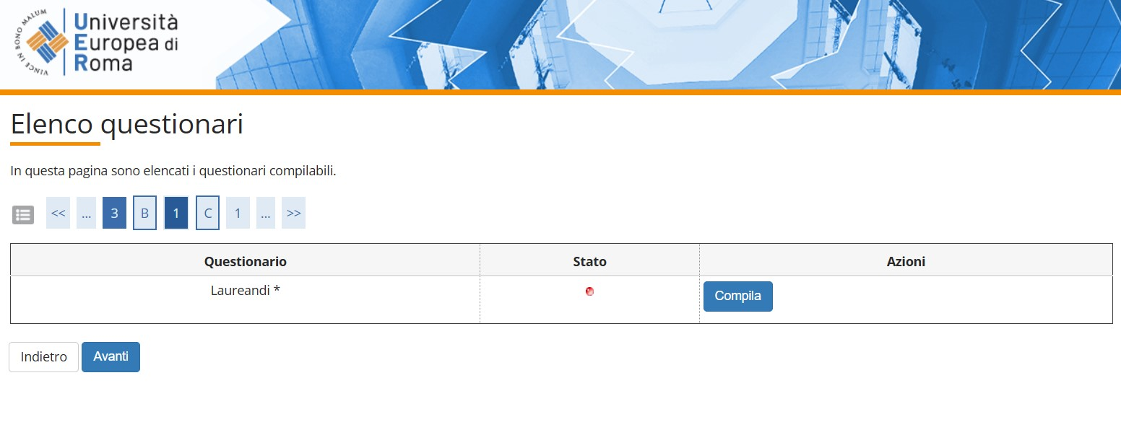
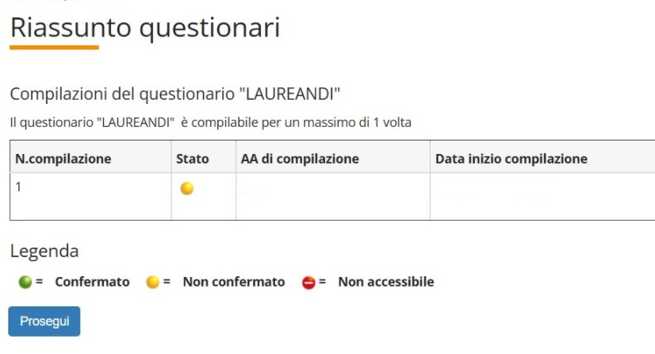
In order to go on with the registration for the exam you will have to complete an Evaluation Questionnaire regarding the subject you are registrating for.
Select the blue botton of Compila and Prosegui on the following page.

Slide 8
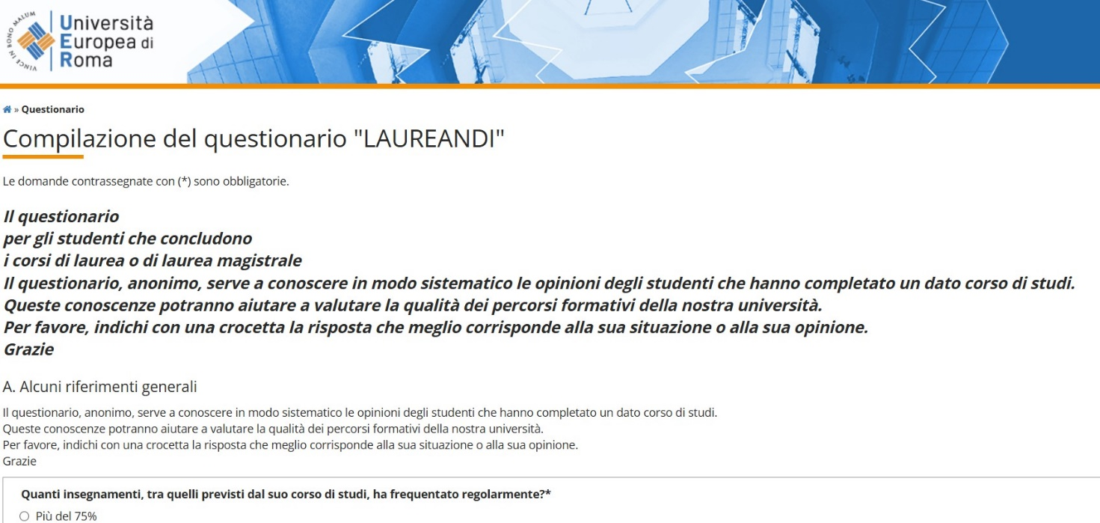
Evaluation Questionnaire
The questionnarie is anonymous.
The questions are different, from the quality of teaching to overall university staff organization and support, for example if the study plan was adequate and con sistent with your expectations, if the studying material provided was helpful and updated, if the overall management of academic activities (class schedules, exams, etc.) were well-organized, etc.

Slide 9
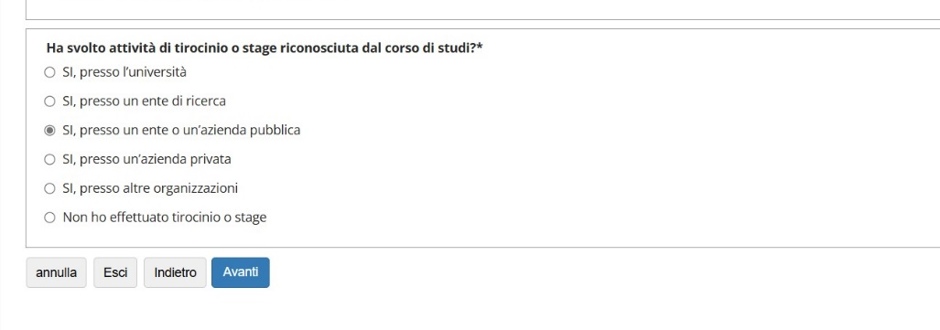
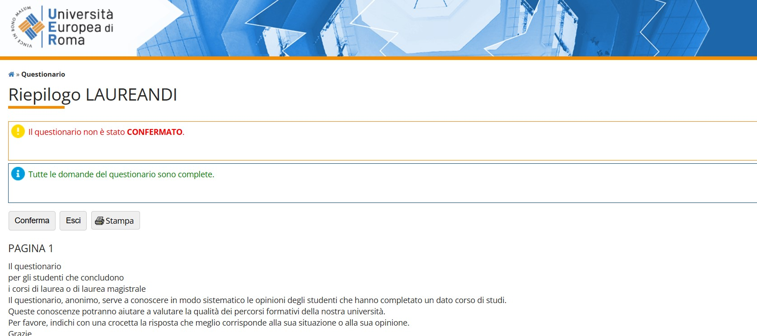
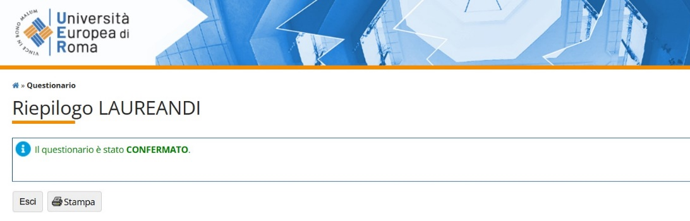
Once you answered all the questions, click on the blue button Avanti.
On the following page click on the grey button Conferma and then Stampa to save the pdf of the completed questionnaire.

Slide 10
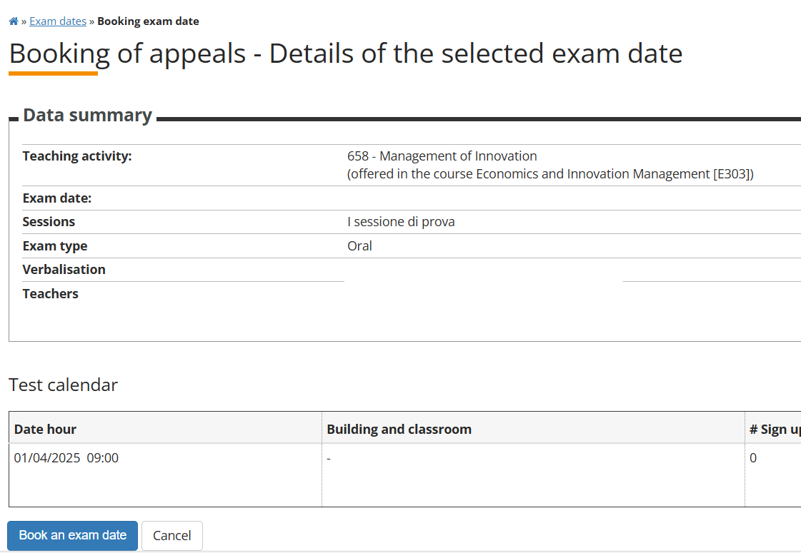
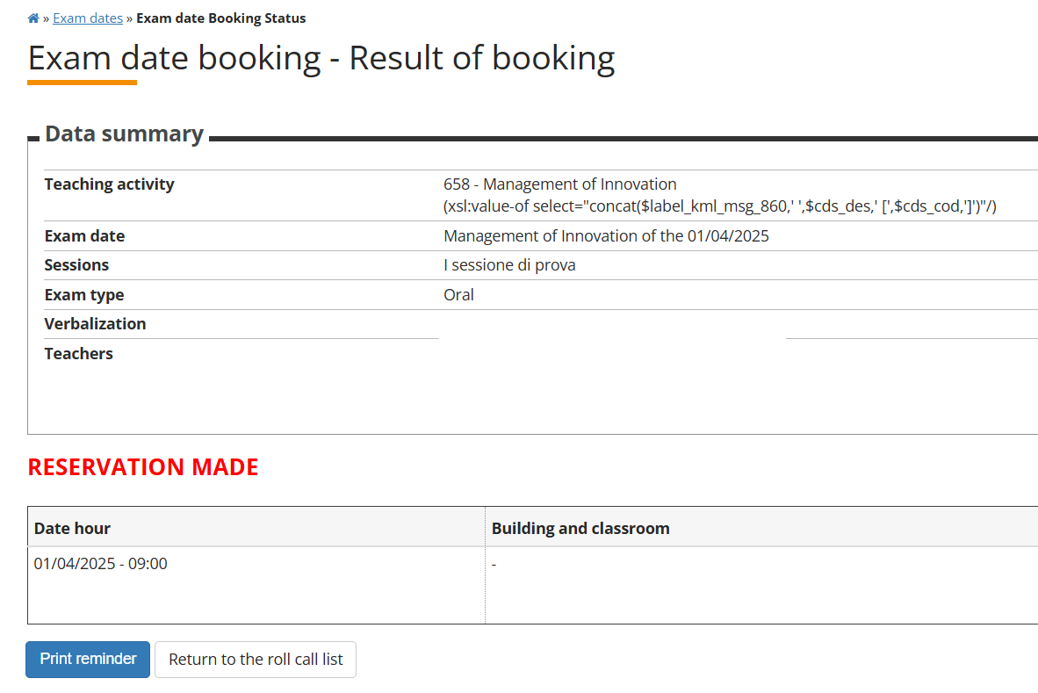
Register to the exam you would like to do your exam by clicking on the blue botton
“Prenotati all’appello” > “Procedi” > “Conferma prenotazione”

Slide 11
2nd Step: Take the exam
The exam dates are published on UER website (International Students > Calendar, Exams and Attendance).
Please find the classroom where the exam will take place in MYUER app (section “Exam calendar”) within 5 days before the exam.
Exams will be held in person.
In case you have two exams the same day at the same hour, you will have to take one of the exams on a different exam session.
You cannot request the exam date to be changed or take the exam online.

Slide 12
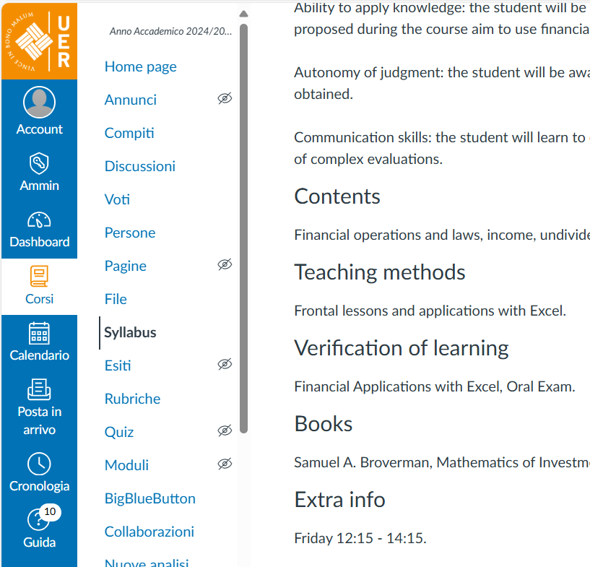
The Italian university system provides two main ways to hold exams:
Oral interview
Written test / Essay / Paper
For more information you should contact your professor or go on the CANVAS platform at the section Syllabus.

Slide 13
FOR ORAL EXAM: the professor will tell you at the end of the oral exam which grade you got.
You can then orally say if you accept it or not.
If you Accept the grade, you will directly see your grade on Esse3.
If you Refuse the grade, you will not see your grade on Esse3 and you will be able to register for the next exam call.

Slide 14

WRITTEN + ORAL EXAM
If the evaluation of a course consists of a written and an oral exam, the written exam will have place first.
You will be given a deadline to send via email the written exam or a date will be set to do the test. You will then need to access the Canvas platform to see the grade of the written exam.
If passing the written exam, you will need to proceed with the oral exam. You will then Accept or Refuse the final grade according to the following procedure (3rd Step).
“IDONEITÀ” EXAMS
When a course has no numerical grade – from 18 to 30 – but only a “passed/not passed” grade, it is called “Esame d’idoneità” , which is the case of some foreign language courses and workshops (laboratori ). Check the syllabus of the courses under the section “Valutazione” to see if they have this kind of exams (most of courses don’t).
For “Idoneità” exams (both oral and written) you do not have to Accept/Refuse the grade in Esse3. You will directly see the grade obtained in the “Bacheca esiti/ Results notice board” section.

Slide 15
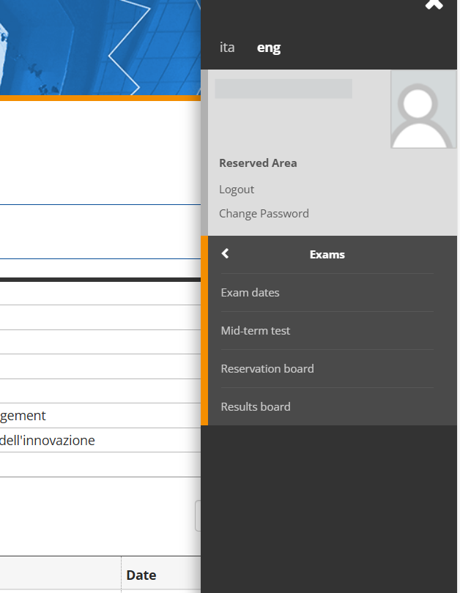
FOR WRITTEN EXAM: the professor will take some days to evaluate the written exam. You will receive an e-mail (to the e-mail address you used to register on Esse3) informing that your grade has been published.
You will need then to Accept or Refuse the grade within 24 hours from receiving the e-mail.
In order to do so, go to the Esse3 platform, log in and go to
Bacheca esiti/Results notice board and Accept / Refuse the grade within 24 hours from receiving the e-mail according to the following procedure (3rd Step).

Slide 16
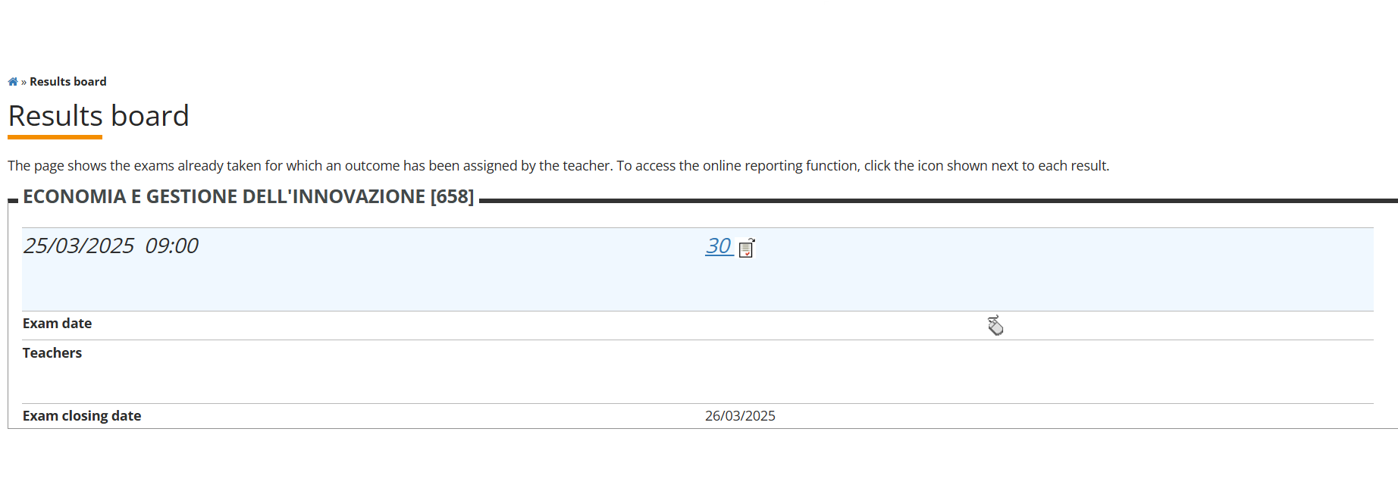
3rd Step: Accept the grade
On the Results Board you will see the list of the exam you did, click on the grade to either Accept (Complete the exam) or Refuse (Withdrawl) and then blue botton Confirm.

Slide 17
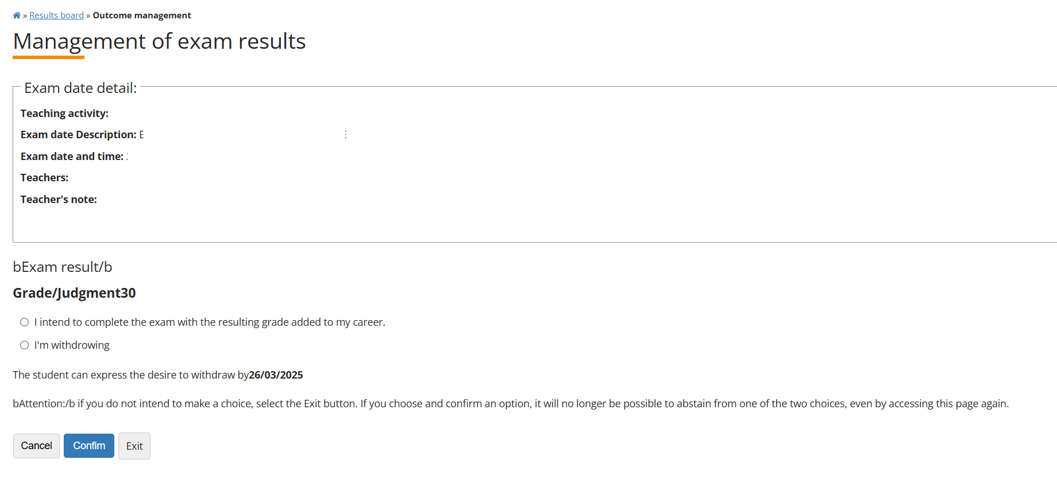

Slide 18
You need to accept your grade after receiving it (this process is called verbalizzazione).
If you do not accept your grade within the established
time (24h), the system will automatically consider the
absence of acceptance as a refuse of the grade,
so you will lose the grade.
However, it is also possible to Refuse a grade and attempt to do the exam another time.
Please, keep in mind the equivalance with the Italian gradying system when Accepting or Refusing the grade.

Slide 19
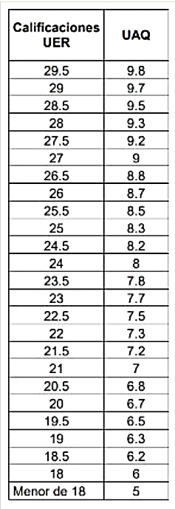
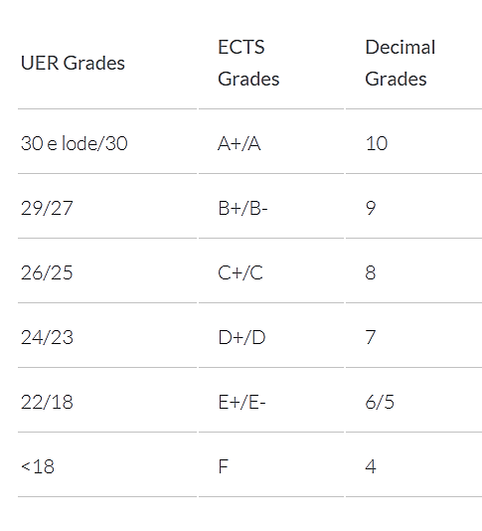

Slide 20





It is the student’s responsibility to constantly check their inbox, including the spam folder, to check if they have received the notification email.
If you failed the exam, refused the grade or didn’t accept the grade within 24 hours from receiving the e-mail, you will need to retake the exam in the following call (in order to obtain the corresponding ECTS).

Slide 21


