Slide 1

PERMIT OF STAY
Within 8 working days of their arrival in Italy, all NON-EU citizens who hold a valid student visa for Italy and intend to stay for longer than 90 days, must apply for a permit of stay for study purposes (Permesso di soggiorno per motivi di studio).

Slide 2
PERMIT OF STAY
HOW TO APPLY

Slide 3
Prepare the kit
Submit the kit
Go to «Questura»
Pick up your permit of stay card

Slide 4


Step 1: Go to the Post Office* and collect the Application Kit
*Closest post office to the UER campus: VIA DELLA PISANA 276, 00163 ROMA (RM)
Applicants only need to complete:
Modulo 1 (Form 1)
Payment slip (Bollettino postale)
Write with a black pen in CAPITAL LETTERS.
Be careful to write inside the boxes (one letter in each box) by following the template below.

Slide 5
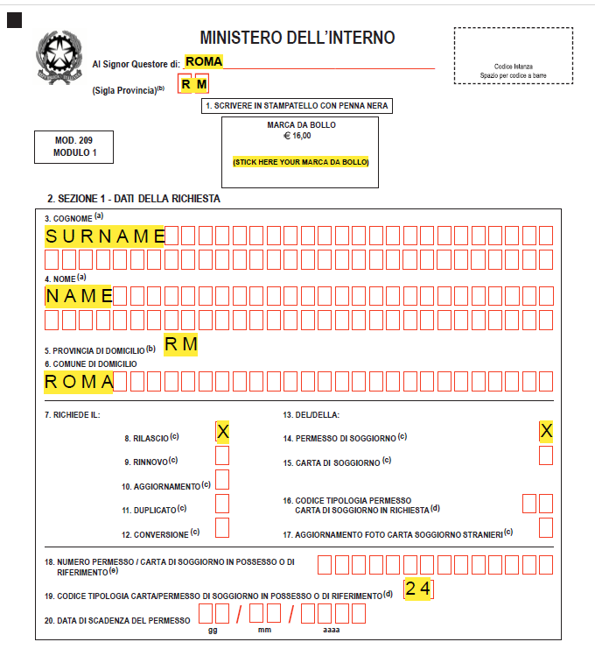

1° Section:
Marca da bollo, to purchase in any «Tabacchi store»

Slide 6
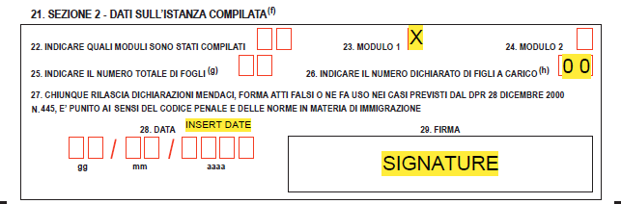
2° Section:

Slide 7
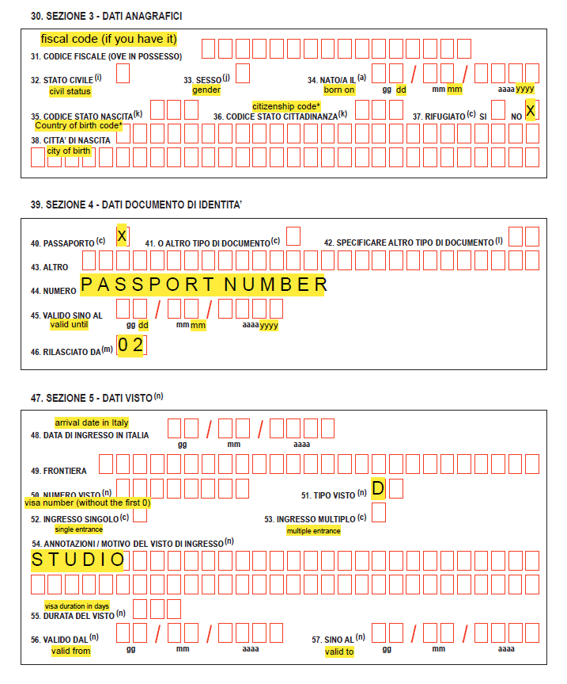
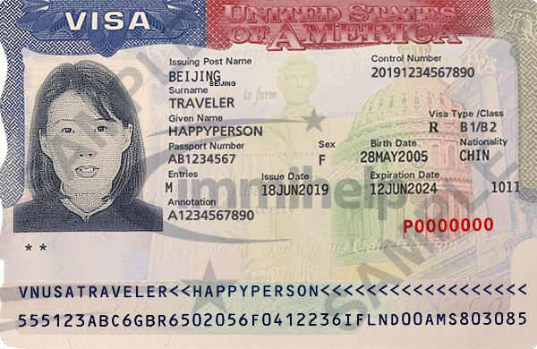
3° Section:
Valid from
Valid to
VISA number

Slide 8
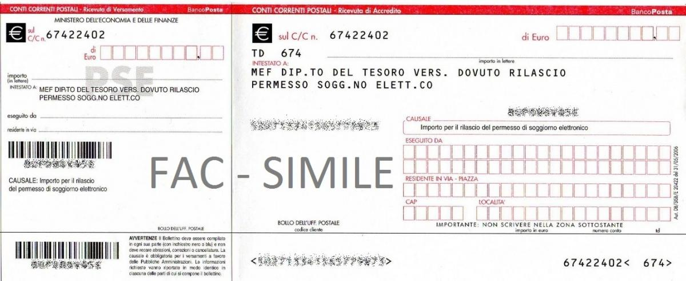
Bollettino postale (Payment slip): the total amount of fee to write is 70,46 euro*
Amount in €
Amount in €
Amount in € (in letters)
Your Name(s) and Surname(s)
Your italian address
Your Name(s) and Surname(s)
Your italian address
Zip code
City
*Cost of the permit of stay for a period of time of minimum 3 months to maximum 1 year: 40 euro
Cost of plastic permit of stay card: 30,46 euro

Slide 9
Step 2: Collect all documents and submit them to the Post Office
Documents to submit:
Application Kit filled (Modulo 1 and Bollettino Postale) together with:
Photocopy of your passport (only pages containing your personal data)
Photocopy of your visa
Copy of health insurance
Copy of the UER Admission letter stamped by the Italian Embassy/Consulate at the time your visa was granted.
A “marca da bollo” : a stamp with a monetary value that they will affix to one of the forms at the post office. You can get a bollo at the Tabacchi nearby, it currently costs €16,00.

Slide 10
Step 2: Collect all documents and submit them to the Post Office
After submitting these documents at the Post Office and paying the total amount (70,46 euro through the payment slip and 30 euro at Post Office the front desk), you will receive the 2 following documents:
A ricevuta (mod.22A, certified letter receipt) with the user ID and password needed to monitor the status of the permit of stay application at http://www.portaleimmigrazione.it/
(click on Area Riservata Stranieri on the bottom right of the page)
A letter with the date and time of the appointment at the Questura to have photos and fingerprints taken.
Students are required to go to the Immigration office on the date
and time specified on the postal receipt.

Slide 11
Step 3: Appointment at the Immigration Office
(Questura – Police Statio – Ufficio Immigrazione)
Bring copies of the same documents submitted together with
The original copy of your passport
4 passport-sized pictures
Certified letter receipt (ricevuta) and appointment letter given by the post office
Proof of accommodation and economic means

Slide 12
Step 4: Collect your permit of stay card
Within 4 to 8 weeks students will receive the next appointment with the Immigration Office for the collection of their permit of stay.
It is possible to track the status of the permit of stay application on the Portale Immigrazione website at http://www.portaleimmigrazione.it/ by accessing it with the user ID and password found on the permit of stay post office receipt (ricevuta).
IMPORTANT: when typing your password, do not include the dash (-).

Slide 13
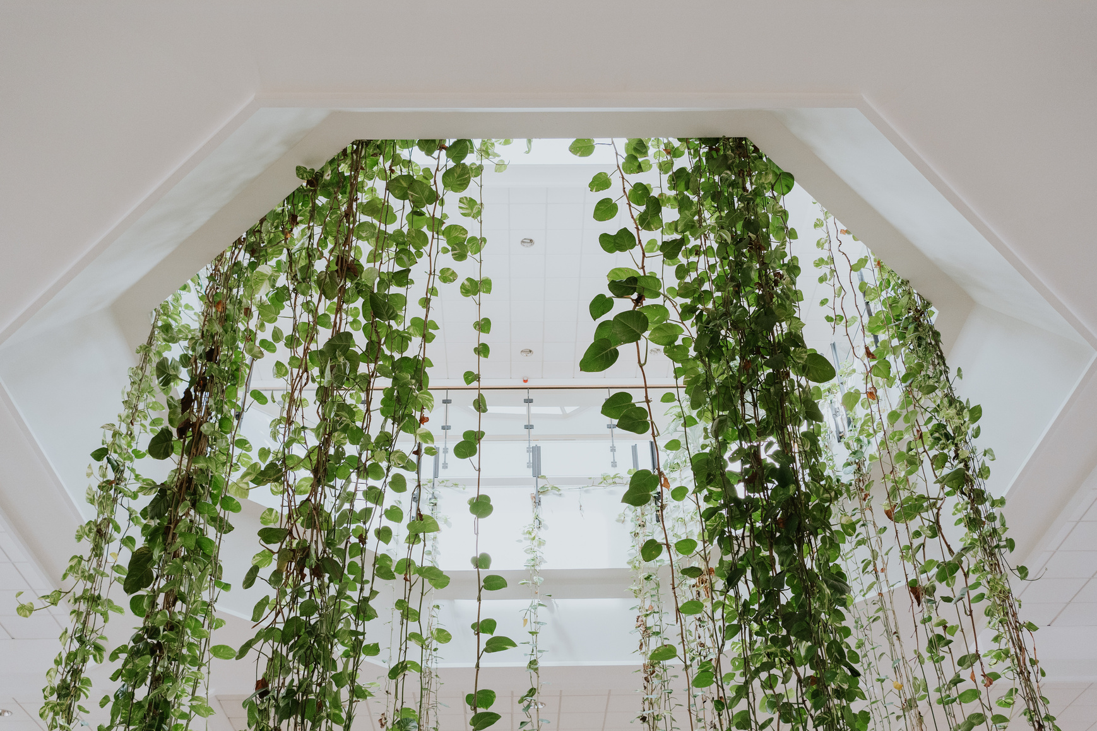

INFORMATION
For further information, please visit:
http://www.portaleimmigrazione.it/
http://www.interno.it/
http://www.poste.it/
http://www.poliziadistato.it/
Please note that this document is intended for guidance only. UER cannot be held responsible for any action taken following these guidelines nor for changes in the law.

Slide 14




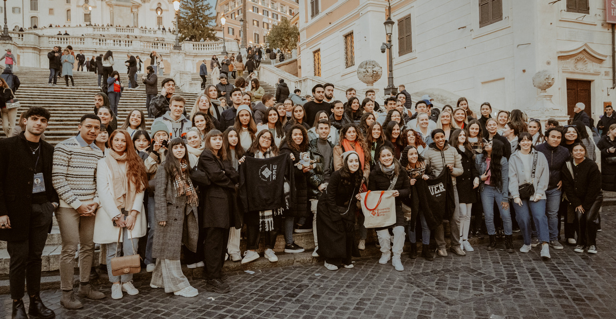
CONTACTS
Contact persons at the receiving institution:
Dott.ssa Laura Polimadei
laura.polimadei@unier.it
Responsible person at the receiving institution:
Prof. Aniello Merone
aniello.merone@unier.it

Slide 15
