Slide 1
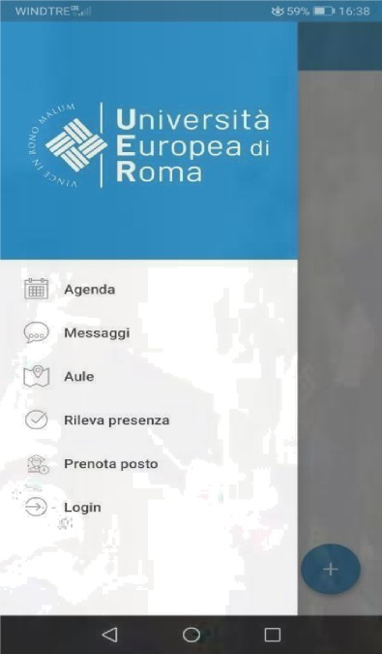

UERCLASS App

Slide 2



UERCLASS is the smartphone app(Android and iOS) used for registering lesson attendance and checking lesson schedules.
You can download UERCLASS App for free from
Google Play Store and Apple Store
Alternative for those who have not an smartphone (google UER agenda web):
https://unierplanner.easystaff.it/agendaweb_uni er//index.php?view=home&include=homepage&
_lang=en

Slide 3
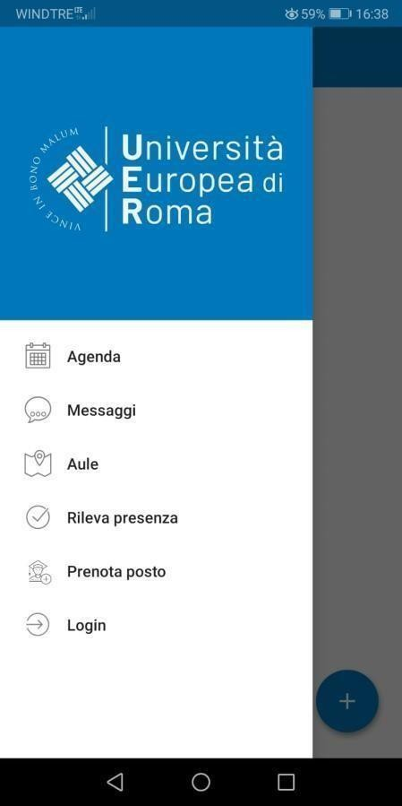
Schedules (Agenda): check lesson schedules
Notices (Messaggi): receive lesson news and notices
Classrooms (Aule): check available classrooms to study
Lesson attendance registration (Rileva presenza):
register your lesson attendance
Book a spot (Prenota posto): to attend lessons in person.

Slide 4



Use your Esse3 credentials
Un we rsi tá Europe a di Roma
Accedi per utilizzare tutte le funzionalità deII'app
username
Password
[**] Accetto l'informativa sulla privacy I(eggi) @ Ho leao le norme sugli accessi ai Io0ali
e
LOG IN

Slide 5
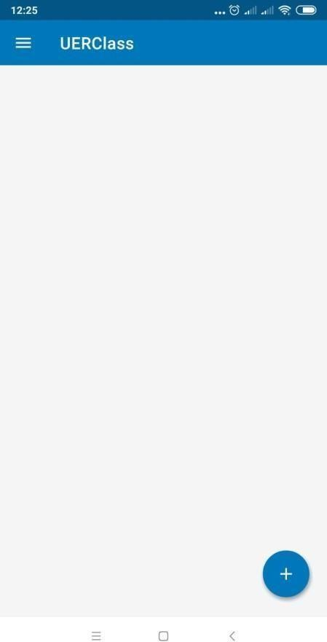
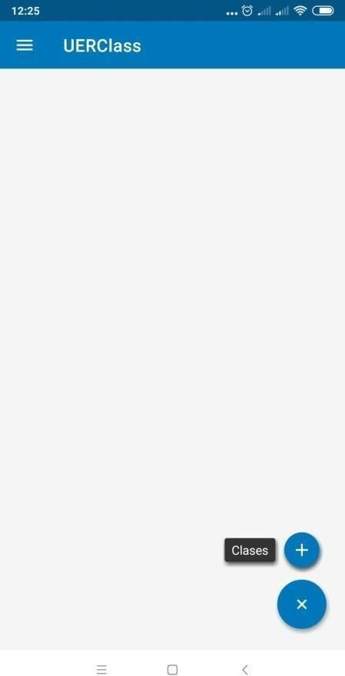
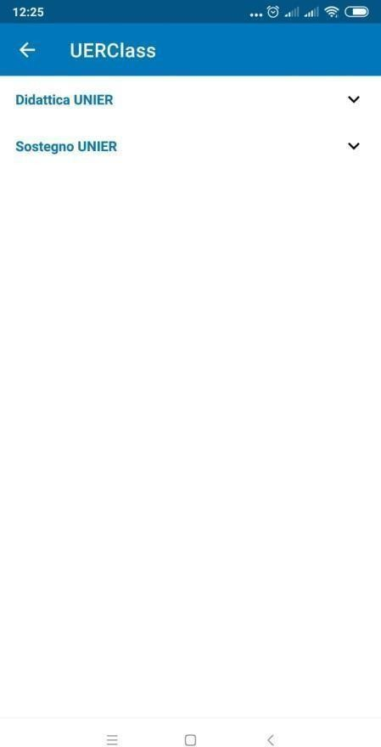
Click on the blue cross> Click on the blue cross again > Didattica UNIER
(in IOS the interface is slighly different, but it works the same)

Slide 6

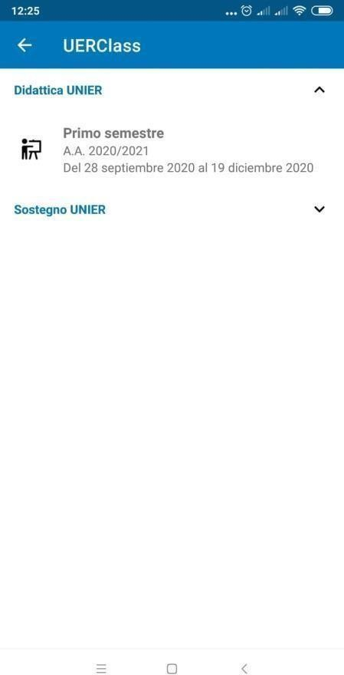
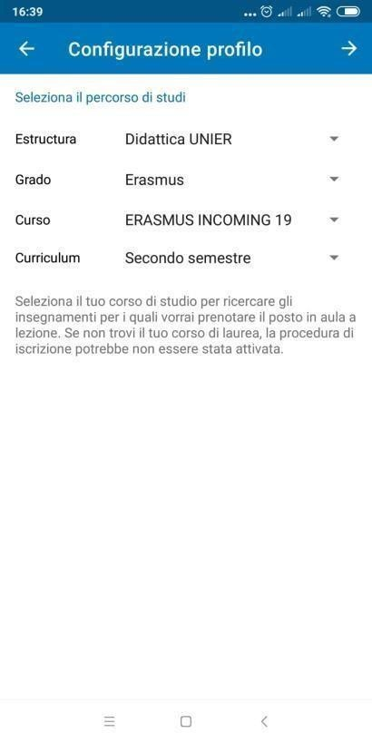
Department: Didattica UNIER
Degree: Erasmus
Course: ERASMUS INCOMING 19
Department: Didattica UNIER
Degree: Erasmus
Course: ERAIN_NEW
Curriculum: secondo semestre
ERAIN_NEW
Curriculum:
Primo Semestre
Primo semestre
Click on the arrow at the upper right corner

Slide 7
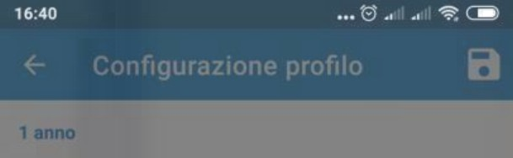






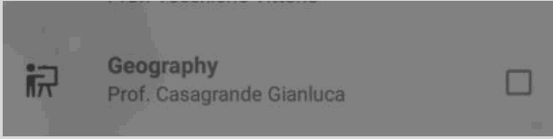






Salva profilo Inserisci l'indirizzo mail in cui vuoi ricevere gli aggiornamenti sulle tue prenotazioni andrea.IIorente@unier.it SNULAR C0NFER**N
Configuraz ione profiIo
Select the courses contained in your Learning Agreement Before Mobility/Predictamen
Digital eommunication
Prof. Camisani Calzolarl Marco
Dlrftto deIl'Unione Europea
Prof. Pace Lorenzo Federico. Rucireta
fWerieAnnunzâta
Prof. Bilorti Emanuele
Insert your e-mail and click on
«conferma»
Enterprise Risk Management
ProKCasagmndeGianuca
History of European integration
Prof. Valente Massimiliano
Human rlghta
Prof. Spatafora ErsiIia9razia
Intercultural education and
ProL Ha*arro Lalanda Sara
Introduction to history of arts and vleual education
Prof. Picardi Paola, Barbieri Costanza
q' w’ e' r t * y u’ i ' o’ p’
a s d f g h j k I
.+ z x c v b n m

Slide 8
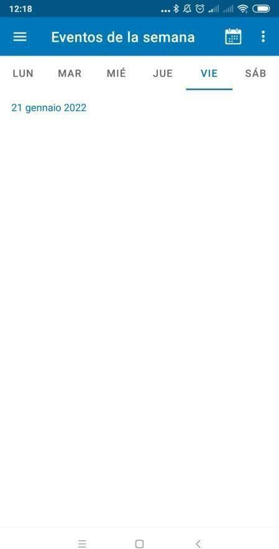
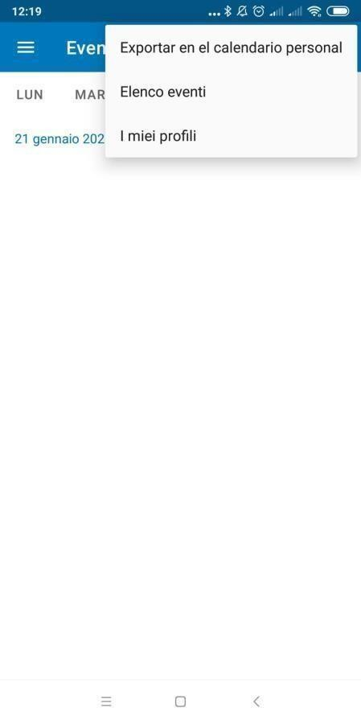
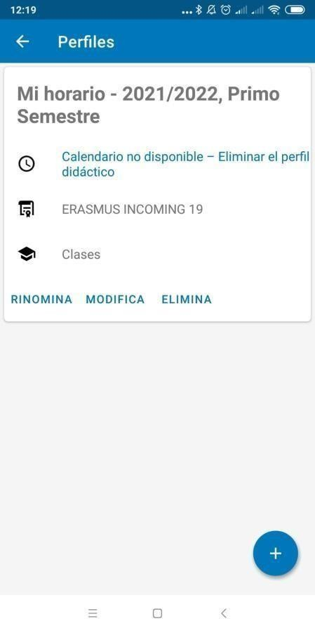
If you need to modify the courses, click on the three dots in the upper right corner> I miei profili> MODIFICA

Slide 9


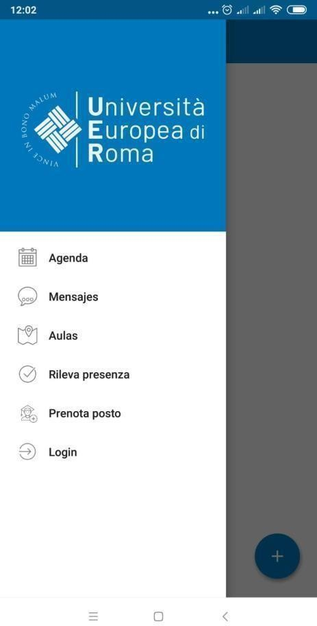
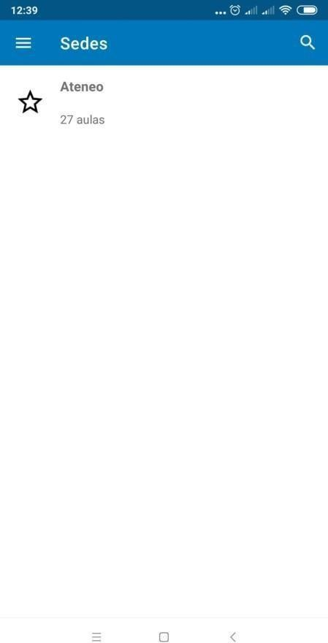
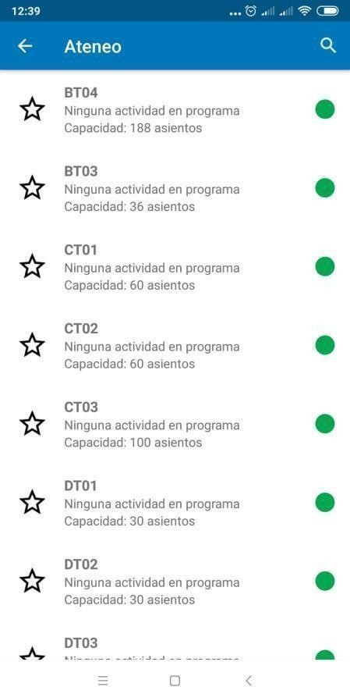

Slide 10



Lesson attendance
Students are required to attend at least 50 % of a course lessons in order to be allowed to take the corresponding exam in the first call of the Spring session in May.
Students who have not attended at least 50% of a course lessons will be exclusively allowed to participate in the last two calls of the Spring session in June and July in person. It is not possible to take exams online.

Slide 11



Students must register their attendance digitally through the UERClass app.
In the unlikely event of misfunctioning of the UERClass app, students need to immediately inform the professor at the end of the same lesson, so that he/she can manually register the student’s attendance at the end of the same lesson. It is not possible to allege at the end of the semester that the minimum attendance has not been registered because of misfunctioning of the UERClass app. Students need to check at the end of each lesson that the percentage of attendance has been successfully registered in the UERClass app.

Slide 12

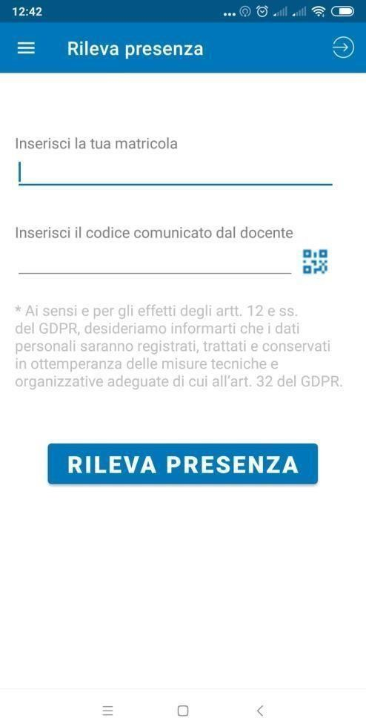
Insert your matriculation number
Scan valid QR code
One lesson registration per device

Slide 13
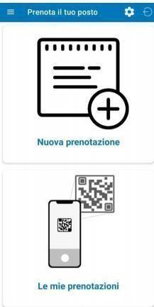

Slide 14
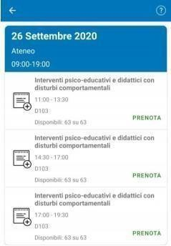
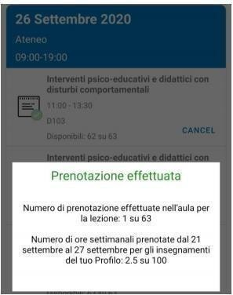
It is only possible to book a spot for lessons taking place in the next 7 days.
It will not be possible to book a spot when the max. capacity of the room has already been reached.
You will receive an e-mail confirming your booking. You can also check your booking in «Le mie prenotazioni».

Slide 15
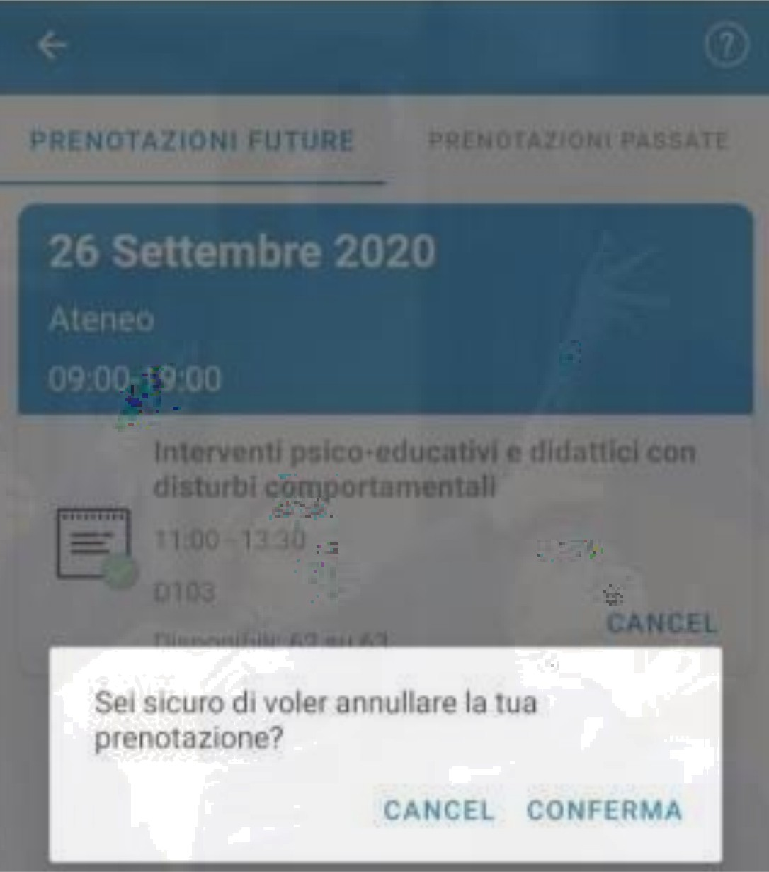
You will be able to cancel your
booking by clicking on «Cancel»
You cannot cancel the booking of a lesson taking place the same day.

