Slide 1



LEARNING PLATFORM CANVAS
USER MANUAL

Slide 2

WHAT IS CANVAS?
The Learning Management System educational platform of the Università Europea di Roma from A.Y. 2022/2023 where teachers upload teaching material such as Power Point presentations, biographies, etc.

Slide 3
ACCESS TO THE PLATFORM
To access Canvas, you need to connect to the following link:
https://uer.instructure.com/
The platform access credentials (Username, Password) are the same as those used to access the ESSE3 system.

Slide 4
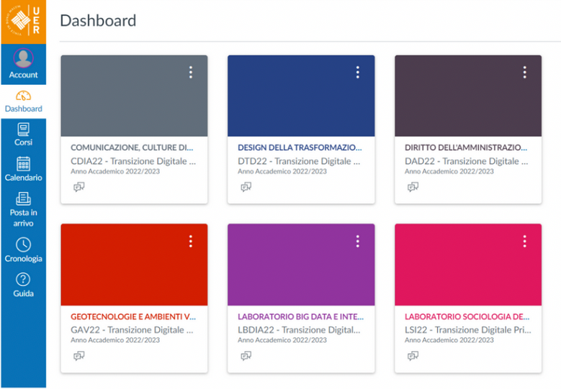



DASHBOARD
After logging in to the platform, the dashboard will be displayed containing the list of courses assigned to the student.
The courses will be available from 01/03/2025 (deadline of the Learning Agreement during the mobility).

Slide 5
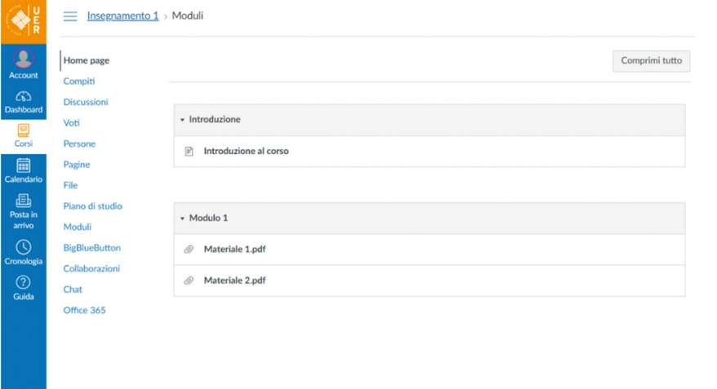
LEARNING MATERIALS
It is possible to view the teaching materials and / or the course contents by clicking on one of the courses on the dashboard.
In courses where no material has yet been uploaded, will be displayed the message:
"Nessun modulo è stato definito per questo corso."

Slide 6
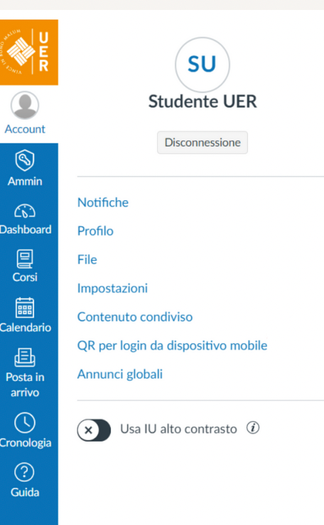


CANVAS STUDENT – APP MOBILE (IOS / ANDROID)
Students can access Canvas from their mobile device:
CANVAS STUDENT - APPLE STORE
CANVAS STUDENT - GOOGLE PLAY

Slide 7
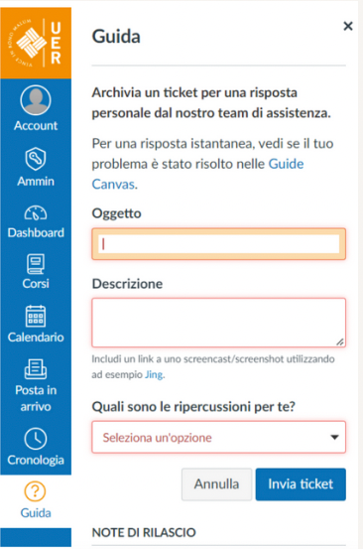

SUPPORT
To request assistance on using Canvas through the platform, go to:
Guida → UER → "Segnala un problema"
Alternatively, you can send an e-mail to the address:
assistenza.informatica@unier.it

Slide 8



