Slide 1


STUDENT SERVICES

Slide 2
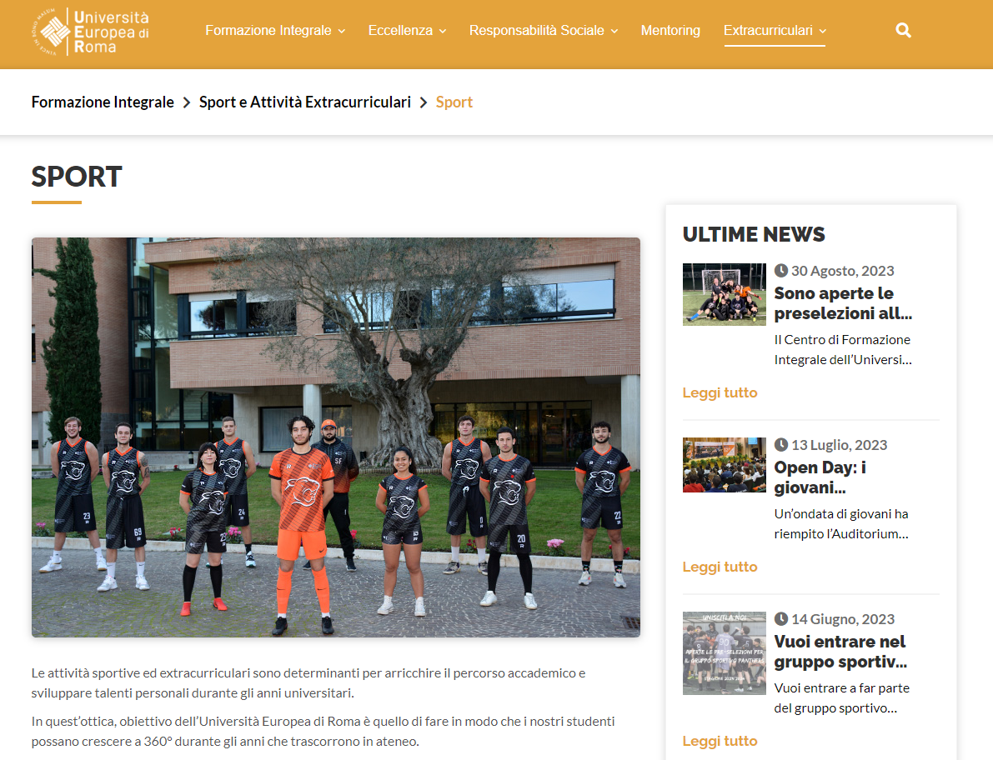
Male/Female football, mixed volleyball, male basketball, rugby, chess, athletics, padel, etc. (https://www.universitaeuropeadiroma.it/formazioneintegrale/sport/)
Rome University League
Two evenings a week at Empire Sport&Resort/Istituto Torricelli
For info: sport.extracurriculari@unier.it or room B317

Slide 3

For other extra-curricular activities (musical, artistic, cultural):​ https://www.universitaeuropeadiroma.it/formazioneintegrale/sport-attivita-extracurriculari/
Agreements: https://www.universitaeuropeadiroma.it/studenti-e-laureati/#tab_convenzioni

