Slide 1


Exams
Fare clic per inserire testo

Slide 2
Exam sessions
You can choose to take your exams in the
Extraordinary session (from 15/12/22 to 21/12/22) AND/OR
Winter session (from 10/01/23 to 18/02/23)
BUT REMEMBER

Slide 3

Lesson attendance registration
(Rileva presenza)
Students are required to attend at least 50 % of a course lessons in order to be allowed to take the corresponding exam in the extraordinary session and the first call of the Winter session.
Students who have not attended at least 50% of a course lessons will be exclusively allowed to participate in the last two calls of the Winter session in January and February in person. It is not possible to take exams online.

Slide 4
Lesson attendance registration
(Rileva presenza)
Students must register their attendance digitally through the UERClass app.
In the unlikely event of misfunctioning of the UERClass app, students need to immediately inform the professor at the end of the same lesson, so that he/she can manually registered the student’s attendance at the end of the same lesson. It is not possible to allege at the end of the semester that the minimum attendance has not been registered because of misfunctioning of the UERClass app

Slide 5
Dates
The exam dates are published on UER website (International Students> Calendar, exams and attendance): https://www.universitaeuropeadiroma.it/en/international-exchanges/

Slide 6
Exam overlap
In case you have two exams the same day at the same hour, you will have to take one of the exams on a different exam session:
You cannot request the exam date to be changed
You cannot take the exam online

Slide 7
Exams process
Step: Register for the exam
Step: Take the exam
Step: Accept the grade

Slide 8
1 Step: Register for the exam
You need to register for each exam from 14 days up to 5 days before the exam. If you don’t, you will miss the exam call, meaning you will have fewer opportunities to pass your exam. In this guide you will find the instructions on how to register for the exams:
https://www.universitaeuropeadiroma.it/wp-content/uploads/2021/05/n.2-exam-registration-in-English.pdf

Slide 9
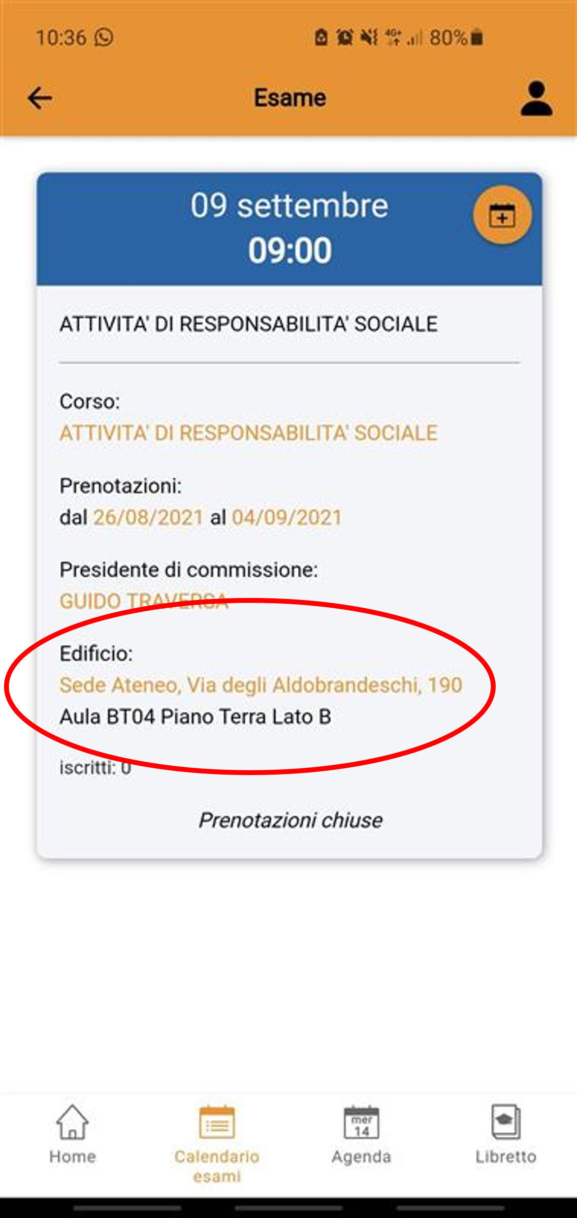
2 Step: Take the exam
Exams will be held in person. Please find the classroom where the exam will take place in MYUER app (section “Exam calendar”) within 5 days before the exam.
In Italy, exams are mostly oral. Check with your professor whether you are going to have an oral or/and a written exam

Slide 10
Step: Accept the grade
You need to accept your grade after receiving it (this process is called verbalizzazione). If you do not accept your grade within the established time, it will be taken for granted that you refuse the grade, so you will lose the grade.
In this guide you will find the instructions on how to accept/refuse the grade:
https://www.universitaeuropeadiroma.it/wp-content/uploads/2022/11/n.8-Verbalizzazione-in-English.pdf

Slide 11
Grading system
Please mind the equivalence with the Italian grading system when accepting/refusing your grade:
https://www.universitaeuropeadiroma.it/en/international-exchanges/#tab_grading-system

