Slide 1
How misguided translations impact users and lead to inaccurate transposition – The case of ‘best efforts’ under Article 17 DCDSM
When translations shape legal systems

Slide 2
Presentation Outline
Broader context
Research scope
Results
‘Best efforts’ concept
Methodology

Slide 3
‘Best Efforts’
Meaning
Translations
Transposition
Harmonization
Article 17 DCDSM
Copyright & related rights
Fundamental rights
Proportionality [Art. 17(5)]
Cooperation [Art. 17(7-8 & 10)]
Article 17(4) vs. Article 17(7)
Obligations - OCSSPs
Polish CJEU Case (C-401/19)

Slide 4
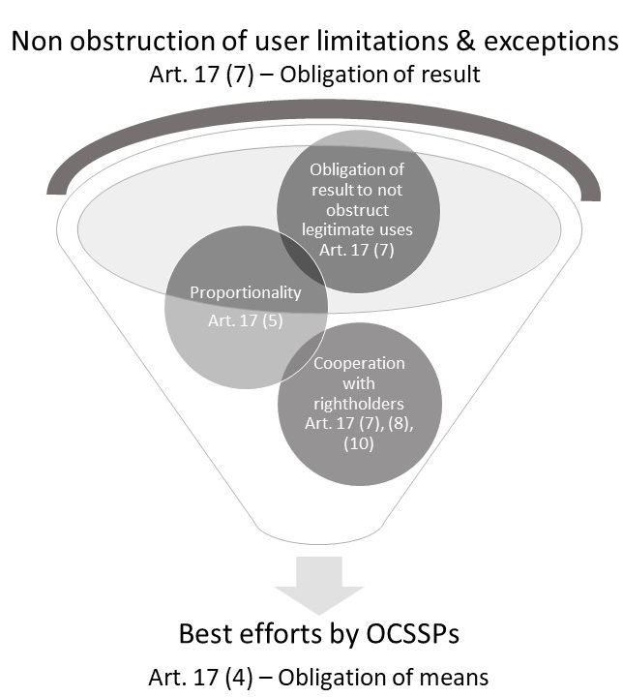

Slide 5
Translation Inaccuracies
Legal uncertainty
Misguided interpretation
Fragmentation
Users, platforms, creators
Incorrect transposition

Slide 7
Foreignization
Domestication
Closest possible match

Slide 8
Translation Approaches: The Good, the Bad, The Ugly
Excessive threshold
Incoherence and inconsistency
A step in the right direction but still inaccurate
The ipssimis verbis
The ‘reasonable’ approach
As close as possible transposition

Slide 9
Illustrations: The Bad
Italy & Portugal and Bulgaria
Italy: Inaccurate transposition due to an excessive threshold
The Italian translation is ‘i massimi sforzi’: this is a manifest translation error as the terminology implies ‘maximum efforts’ instead of ‘best efforts’. This should, at a minimum, be corrected in the national transposition process.
Portugal & Bulgaria: Inaccurate transposition due to excessive thresholds used in a non-coherent and inconsistent manner
The Portuguese and Bulgarian translation do not follow the original text’s consistent approach of using ‘best efforts’ throughout Article 17(4), instead they mix various terminologies. (Portugal: ‘all efforts’ combined with ‘best efforts’; Bulgaria: ‘made all possible efforts’ mixed with ‘made maximum efforts’)

Slide 10
Illustrations: The Ugly
Germany
Germany: Risk of inaccurate transposition resulting from use of a wrong standard combined with accurate justification at first but rectified in the latest proposal
Initially it kept the wording in the DCDSM’s official German translation: inaccurately translating ‘best efforts’ into ‘alle Anstrengungen’.
It highlighted the problem in the legislation’s explanatory remarks to avoid it being interpreted as setting an obligation of ‘all efforts’ = still a risk of an inaccurate implementation or incorrect interpretations by stakeholders.
The German proposal switched very recently to ‘bestmögliche Anstrengungen’, an expression much closer to the original ‘best efforts’ standard. National legislators can remedy inaccurate translation!

Slide 11
Illustrations: The Good
Germany
The Netherlands: As close as possible transposition when the ‘efforts’ standard cannot be transposed as such
The initial proposal was to translate ‘best efforts’ into ‘have done everything possible’ (‘alles in het werk hebben gesteld’) based on an incorrect translation in EU Official Journal as starting point.
The text adopted by the Second Chamber switched to ‘best ability’ (‘beste vermogen’), a standard closer to the legal concept of ‘best efforts’, as used in the DCDSM.

Slide 12
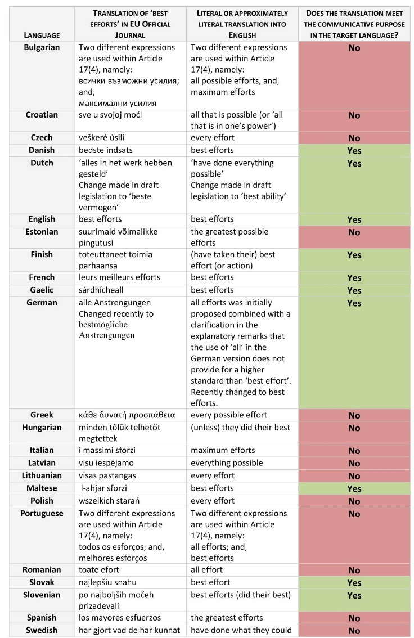
The ultimate irony:
Fragmentation resulting from a Single Market Directive
Only in 10 out of the 24 official EU languages ‘best efforts’ was translated through an equivalent expression
Language | Translation of ‘best efforts’ in EU Official Journal | Literal or approximately literal translation into English | Does the translation meet the communicative purpose in the target language?
English | best efforts | best efforts | Yes
French | leurs meilleurs efforts | best efforts | Yes
Italian | i massimi sforzi | maximum efforts | No

Slide 13
The way forward –
three elementary strategies for accurately translating ‘best efforts’
a literal translation (even when it implies foreignization);
translating it as ‘reasonable efforts’ (whenever it finds more resonance in legal language use); and,
(in the absence of the former strategies) employing another grammatical construct with an equivalent meaning.
At any rate, expressions going beyond the original text’s scope, such as ‘all’ or ‘maximum’ like in the Italian translation, must be avoided.

Slide 14
The way forward –
Article 17 is Framed by ‘Proportionality’ (§5)
& Cooperation (§§7-8 & §10)
Article 17 refers to the following concepts to set the context and boundaries for the interpretative framework defining the scope and breadth of ‘best efforts’:
‘proportionality’ (§5);
‘cooperation’ (§§7-8 & §10).
The EU institutions have further defined these boundaries by clarifying that the ‘best efforts’ required are part of an ‘obligation of means’, limited by the ‘obligation of result’ to not obstruct the limitations and exceptions of users (§7).

Slide 15
The way forward –
Keep ‘best efforts’ at a level of reasonableness
Catch 22 dilemma for OCSSPs: Excessive thresholds, like in the Italian translation, leaves OCSSPs no other option than to:
block content under the ‘obligation of means’ set out under Article 17(4); and,
breach Article 17(7)’s ‘obligation of result’ to not impede users exceptions and limitations.
Impacting users’ fundamental rights & jeopardizing OCSSPs’ functioning, especially hurting smaller (EU) ones.
Member States need to keep Article 17(4)’s ‘best efforts’ standard at a level of reasonableness to ensure that the national transpositions take due account of proportionality and the cooperation with rightholders.

Slide 16
The way forward –
Fix @ 2 Levels: EC & National Implementation
To fix the apparent translations errors identified and ensure that the contextual framework limiting Article 17’s ‘best efforts’ concept is taken into account, the EC and the Member States need to:
European Commission: | Issue corrigenda for incorrect language versions.
Member States: | Implement ‘best efforts’ correctly, as translation errors are manifest.
Italy should follow the examples of Germany and the Netherlands, showing that national legislators can remedy inaccurate EU Official Journal translations.

